Slide 1

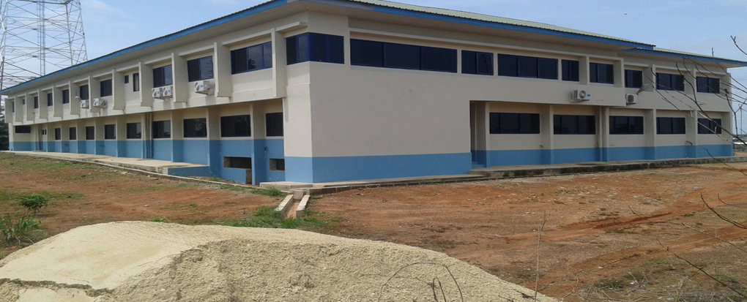
AMANSIE CENTRAL DISTRICT ASSEMBLY
PRESENTATION ON
2022 COMPOSITE BUDGET HEARING
Presented by: hon. MICHAEL DONKOR(District chief executive)
TUESDAY 19TH OCTOBER,2021

Slide 2
OUTLINE -Introduction -Strategic Overview of the District Assembly -Financial Performance – Revenue -Financial Performance – Expenditure -Key Achievements for 2021 -2021 Budget Programme Performance -Outlook for 2022-2025

Slide 3
BACKGROUND
PROFILE OF THE DISTRICT
Amansie Central District Assembly is one of the Forty Three (43) Administrative Districts in the Ashanti Region. It was carved out of the former Bekwai District in 2004 by Legislative Instrument (L.I.) 1774.
POPULATION SIZE AND GROWTH RATES
Population of the district according to 2010 Population and Housing Census is 90,741 persons. This constitutes 50.1% females and 49.9% males.
The current estimated population (2021) of the district is 110,667 persons and projected at 113,220 persons for 2022 with a population growth rate of 2.18%.
The District has a land area of about 710 km² with a 2020 population density of 155.9 persons per km².
The District has about 206 communities with Jacobu as the Administrative Capital.
Notable Towns of the District are: Jacobu, Afoako, Fiankoma, Aboabo, Oseikrom, Esereso, Patase, Asikasu, Krofrom, Nkoduase, Amamom, Akatakyieso, Mile 14, Numereso, Abuakwaa, Tweapease, Huu, Bepotenten and Amponya among others.

Slide 4
DISTRICT ECONOMY
AGRICULTURE
The Local economy is dominated by the Agriculture sector. It employs about 78% of the Labour force in the district. However, due to relatively small farm sizes and low yields, poverty level among the farmers is very high. Farmers in the District are predominantly peasant, cultivating food crops and few cash crops. The food crops include cassava, plantain, cocoyam, yam, rice and maize. The cash crops are cocoa, oil palm and citrus. A major problem of Agriculture in the district is poor storage facilities and poor road conditions resulting in high post-harvest losses.
ROAD
Transport serves as a vital utility which has direct impact on the socio economic and the political aspects of the people. Most parts of the district lack tarred roads. The road densities are low, meaning that roads are not connecting many communities. This sparseness of the roads contributes to poor supply of food and other farm produce such as cocoa, cassava, and timber from production centers resulting in high post-harvest losses. Accessibility to services could therefore be described as poor.

Slide 5
HEALTH
The District has only one hospital located at the district capital, Jacobu and 8 Health Centres located at Tweapease, Mile 14, Numereso, Abuakwaa, Fenaso No.1, Fiankoma, Atobiase and Apitisu.
There are 14 trained Traditional Birth Attendants (TBAs) and 4 CHPS compounds which complement the services of the Hospital.
Key personnel in the District's Health Delivery System include:
7 Medical officers (4 are Specialists and 3 are Physician Assistants)
1 Pharmacist
50 General Nurses
96 Enrolled Nurses
35 Midwives
81 Community Health Nurse
The doctor to population ratio is 1:14,065 and nurse to population ratio is 1:674. This puts too much burden on Doctors and Nurses.
The high ratios coupled with inadequate logistical support have negatively impacted on health delivery system in the District.
Due to this situation, the District Health Directorate and the District Assembly are taking steps to increase the number of doctors and nurses and other vital health personnel and also increase infrastructure, equipment and other medical supplies.

Slide 6
WATER AND SANITATION
The District has a total number of 42 toilet facilities comprising:
37 Aqua Privy toilets
4 Water Closets (WCs)
1 Vault Chamber
There are 257 Boreholes, 56 Hand Dug Wells and 1 Small Town Water system in the District. This puts the District portable water coverage at 80%.
About 70% of the house holds in the district have no access to toilet facilities.
In terms of Solid waste disposal, open dumping of refuse is about 80%.
Sanitation situation in the larger communities such as Jacobu, Tweapease, Afoako and Fiankoma have peculiar problems due to rapid increase in their population. However sanitation situation in the smaller communities is rather relatively better due to their small population sizes.
The drainage system is also very poor resulting in excessive erosion which leads to erosive settlements.
The poor environmental situation arising from improper waste disposal has therefore led to the prevalence of diseases like diarrhoea, cholera and malaria.

Slide 7
EDUCATION
The District has 104 Pre-schools, 102 Primary schools, 45 Junior High Schools, 2 Senior High Schools and 1Vocational/Technical School. Accessibility to the Senior High School is very limited due to the limitation to some boarding facilities in the School
GEOLOGY AND MINERALS
The District is underlain by three geological formations. These are the Birimian, Tarkwaian and Granite rocks which are rich in mineral deposits. Gold is abundant in the district and mostly located at Apitisu, Amamom, Anyankyiremu, Adubrim, Fiankoma, Jacobu and Aketechieso. In addition, there are sand and gravel deposits at Patase, Afoako, Esreso, Asikasu, Nkoduasi and Amponya.
It provides employment for most youths in the district, but has a major disadvantage of destroying the land.

Slide 8
KEY DEVELOPMENT ISSUES /CHALLENGES
The following are some of the issues of the district which emanated out of a field survey:
Low Revenue Mobilisation in the district
Inadequate Electricity Coverage/Supply
Poor road condition
Inadequate Market Infrastructure
Inadequate Agricultural Extension Officers
Inadequate Educational Infrastructure
Inadequate Health Facilities
Inadequate Potable Drinking Water
Inadequate Toilet Facilities
Inadequate Drainage System
Inadequate Residential Accommodation for Public Sector Workers
Land Degradation

Slide 9
ADOPTED POLICY OBJECTIVES
The following are the major policy objectives of the 2022 Composite Budget:
Ensure Universal Access To Affordable, Reliable & Modern Energy Services.
Achieve universal health coverage and access to quality health-care service
Sanitation for all and to end Open Defecation by 2030, Universal access to Safe Drinking Water by 2030
Ensure free, equitable and quality education for all by 2030
Improve Agriculture production efficiency and yield
End abuse, exploitation and violence in the District
Integrate climate change measures, Reduce vulnerability to climate-related events and disasters
To Improve Production Efficiency And Yield In The District
Strengthen domestic resource mobilization
Improve transport and road safety

Slide 10
VISION OF THE ASSEMBLY
The vision of the Assembly is to create an optimistic, self-confidence and prosperous district within a democratic, open and fair society in which mutual trust and economic opportunities exist for all.
MISSION OF THE ASSEMBLY
Amansie Central District Assembly exists to improve the living standard of the people in the District through collaboration with relevant stakeholders to implement Programs and Projects relating to human development, income generation, employable skills and infrastructural development.

Slide 11
CORE FUNCTIONS OF THE ASSEMBLY
The Assembly exercises political and administrative authority, provides guidance, gives direction and supervises all other administrative authorities in the district.
The Assembly is responsible for the overall development of the district and formulates, as well as executes plans, programmes and strategies for the effective mobilization of the resources necessary for overall development of the District.
It promotes and supports productive activities and social development in the district and initiates programmes for the development of basic infrastructure.
The Assembly is responsible for the development, improvement and management of human settlements and the environment in the district.
The Assembly guides, encourages and supports sub-district local government bodies, public agencies and local communities to perform their roles in the execution of approved development plans.
The Assembly monitors the execution of projects under approved development plans, assesses and evaluates their impact on the people’s development, the district and the national economy.
The Assembly maintains law and order and provides adequate security for the populace.

Slide 12
FINANCIAL PERFORMANCE-REVENUE
REVENUE PERFORMANCE- IGF ONLY
ITEM | 2019 |  | 2020 |  | 2021
 | Budget | Actual | Budget | Actual | Budget | Actual as at July | % performance as at July
Property Rate | 118740.30 | 197,366.82 | 118,740.30 | 218,859.64 | 154,362.39 | 62,268.28 | 18.25
Other Rates |  |  | 1,100.00 | 0.00 | 1,200.00 | 0.00 | 0.00
Fees | 76,549.90 | 54,038.50 | 77,068.11 | 73,528.00 | 83,567.90 | 61,419.00 | 18.00
Fines | 5,000.00 | 0.00 | 5,000.00 | 0.00 | 5,000.00 | 0.00 | 0.00
Licenses | 228,571.73 | 206,097.76 | 232,433.14 | 241,524.39 | 369,408.51 | 208,037.70 | 60.97
Land | 101,020.00 | 75,276.29 | 105,020.00 | 85,175.96 | 109,271.00 | 0.00 | 0.00
Rent | 16,984.00 | 4,929.25 | 18,984.00 | 10,788.55 | 19,933.20 | 9,490.00 | 2.78
Investment | 0.00 | 0.00 | 0.00 | 0.00 | 0.00 | 0.00 | 0.00
TOTAL | 558,765.93 | 539,082.40 | 570,627.55 | 619,087.99 | 742,743.00 | 341,214.98 | 100.00

Slide 13
FINANCIAL PERFORMANCE-EXPENDITURE
EXPENDITURE PERFORMANCE (ALL DEPARTMENTS) GOG ONLY
Expenditure | 2019 |  | 2020 |  | 2021
 | Budget | Actual | Budget | Actual | Budget | Actual as at July | % Performance (as at July)
Compensation | 1,516,986.00 | 1,741,944.24 | 1,862,878.23 | 2,145,046.63 | 2,023,770.63 | 1,011,885.30 | 50.00
Goods and Services | 269,394.99 | 150,392.79 | 75,415.24 | 59,284.83 | 83,668.00 | 53,070.00 | 63.43
Assets | - | - | - | - | - | - | -
Total | 1,786,380.99 | 1,892,337.03 | 1,938,293.47 | 2,204,331.46 | 2,107,438.63 | 1,064,955.30 | 50.53

Slide 14
FINANCIAL PERFORMANCE-REVENUE
REVENUE PERFORMANCE- ALL REVENUE SOURCES
ITEM | 2019 |  | 2020 |  | 2021
 | Budget | Actual | Budget | Actual | Budget | Actual as at July | % performance as at July
IGF | 558,765.93 | 539,082.40 | 570,627.55 | 634,223.07 | 668,254.00 | 649,920.98 | 97.25
Compensation Transfer | 1,689,548.61 | 1,621,342.24 | 1,862,878.22 | 2,145,046.63 | 2,023,770.63 | 1,011,885.30 | 50.00
Goods and Services Transfer | 269,394.99 | 150,392.79 | 75,415.24 | 59,292.33 | 83,668.00 | 53,197.88 | 63.58
Assets Transfer | 0.00 | 0.00 | 0.00 | 0.00 | 0.00 | 0.00 | 0.00
DACF | 3,875,072.56 | 2,088,216.54 | 4,002,454.39 | 2,578,362.51 | 4,946,772.14 | 143,998.44 | 2.91
DACF-RFG | 896,172.91 | 896,172.91 | 811,959.38 | 579,976.43 | 1,535,057.00 | 1,195,422 | 77.87
MAG | 0.00 | 0.00 | 250,000.00 | 275,779.67 | 250,000.00 | 73,784.15 | 29.51
Secondary Cities | - | - | - | - | - | - | -
Stool Lands |  |  |  |  | 89,271.00 | 344,283.48 | 385.66
Total | 7,288,955.00 | 5,295,206.98 | 7,573,334.78 | 6,272,680.64 | 9,596,792.77 | 2,588,867.89 | 26.98

Slide 15
FINANCIAL PERFORMANCE-EXPENDITURE
EXPENDITURE PERFORMANCE (ALL DEPARTMENTS) IGF ONLY
Expenditure | 2019 |  | 2020 |  | 2021
 | Budget | Actual | Budget | Actual | Budget | Actual as at July | % age Performance as at July
Compensation | 132,968.47 | 134,691.37 | 214,828.04 | 166,668.78 | 161,141.00 | 86,488.98 | 53.67
Goods and Services | 270,939.90 | 288,101.16 | 332,500.50 | 419,000.52 | 548,384.00 | 589,704.44 | 107.53
Assets | 154,857.56 | 0.00 | 23,299.00 | 29,565.21 | 48,000.00 | 218,642.28 | 455.5
Total | 558,765.93 | 422,792.53 | 570,627.54 | 615,234.51 | 757,525.00 | 894,835.70 | 118.12

Slide 16
FINANCIAL PERFORMANCE-EXPENDITURE
EXPENDITURE PERFORMANCE (ALL DEPARTMENTS) ALL FUNDING SOURCES
Expenditure | 2019 |  | 2020 |  | 2021
 | Budget | Actual | Budget | Actual | Budget | Actual as at July | % age Performance as at July
Compensation | 1,923,835.00 | 1,876,635.61 | 2,077,706.27 | 2,311,715.41 | 2,184,911.63 | 1,098,374.28 | 50.27
Goods and Services | 2,689,565.00 | 1,800,575.38 | 2,647,770.75 | 2,207,787.44 | 2,716,851.14 | 963,293.94 | 35.45
Assets | 2,675,555.00 | 950,543.05 | 2,871,473.76 | 1,912,700.92 | 4,695,030.00 | 527,199.67 | 11.22
Total | 7,288,955.00 | 4,652,836.18 | 7,573,334.78 | 6,432,203.77 | 9,596,792.77 | 2,588,867.89 | 26.98

Slide 17
NON FINANCIAL PERFORMANCE BY PROGRAMMES

Slide 18
KEY ACHIEVEMENTS (2021)
Construction of 1No. 2Unit KG Block at Anyeme.
Renovation of Afoako R/C JHS School Building.
Provision of 597 Dual desks and 465 Mono desks to various schools in the district.
Five (5) rice demonstrations established at Kentey, Mmoodebam’, Mile 14, and Essaase.
Seventeen (17) maize demonstrations conducted during the period at the office and all operational areas.

Slide 19
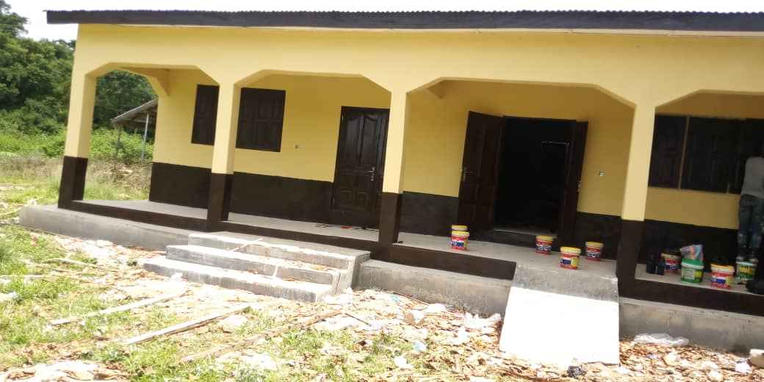
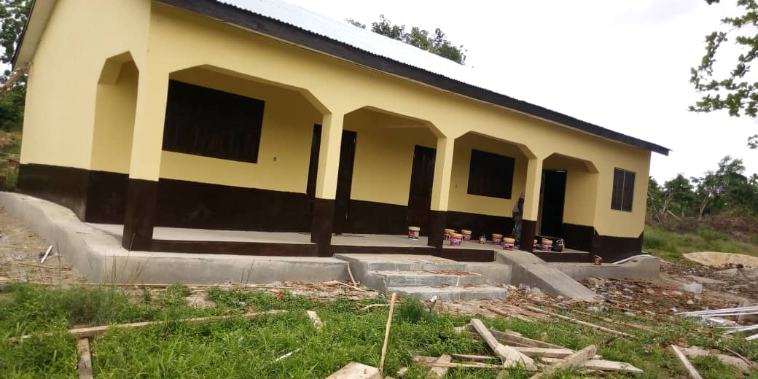
Construction of 1No. 2Unit KG Block at Anyame

Slide 20
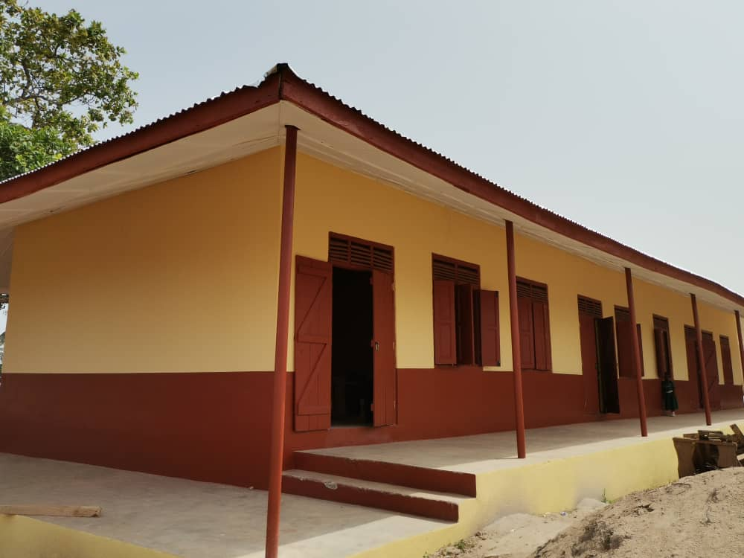
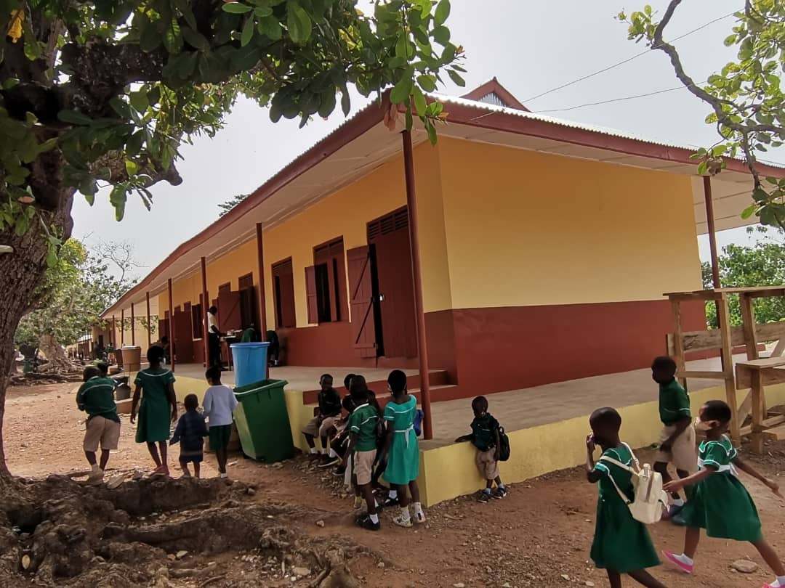
Renovation of Afoako R/C JHS School Building.

Slide 21
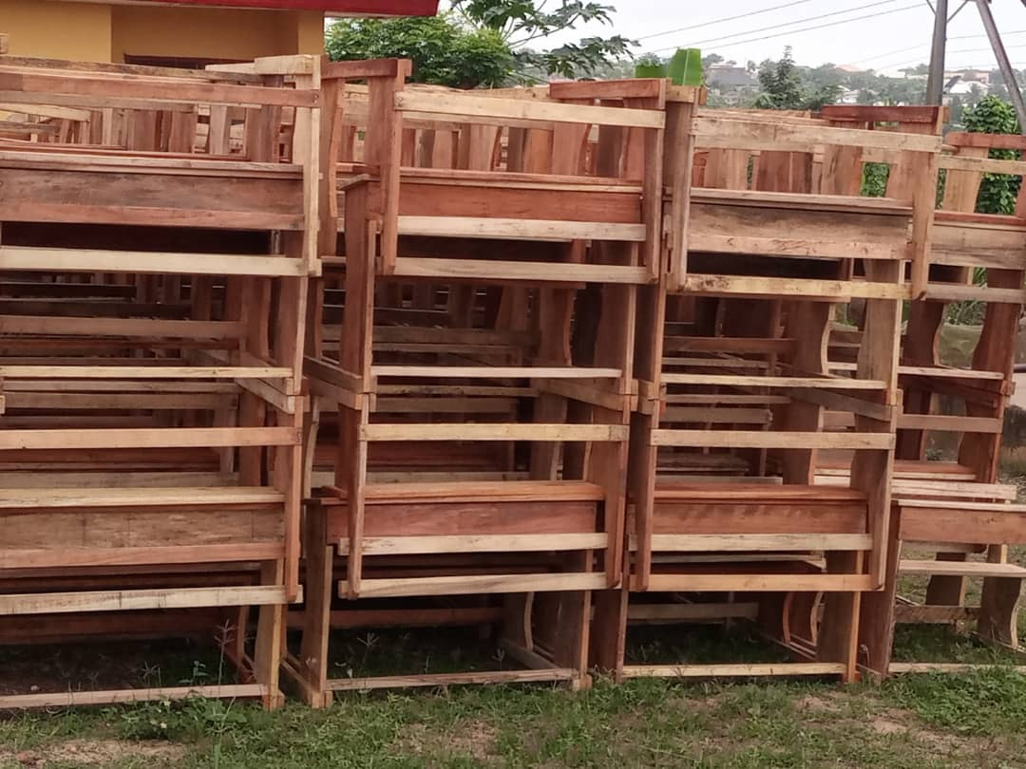
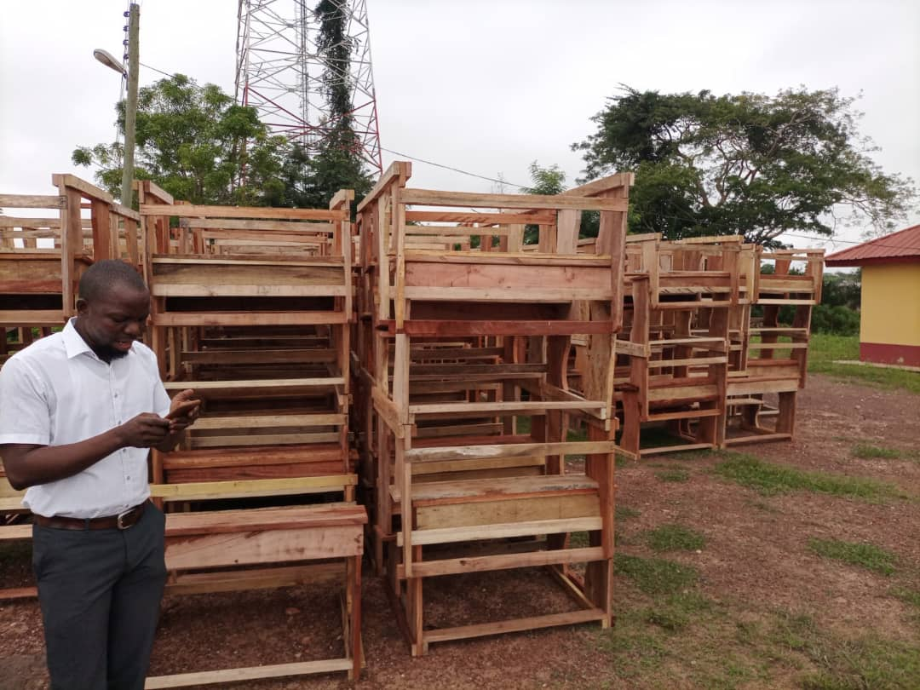
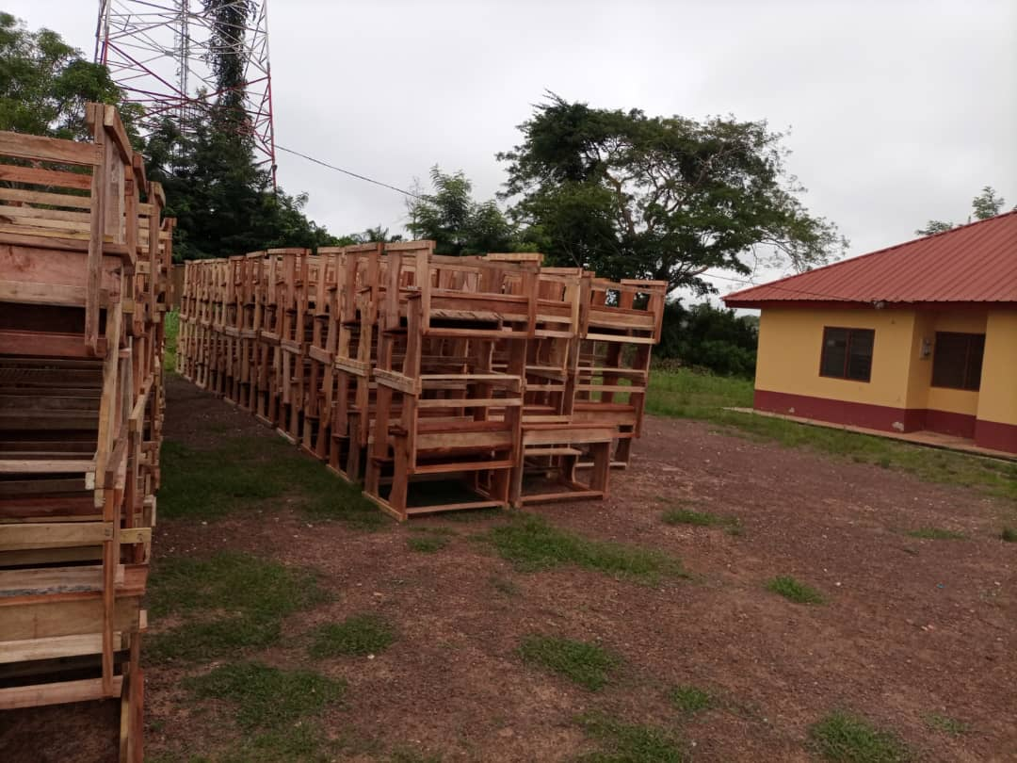
Provision of 597 Dual desks and 465 Mono desks to various schools in the district.

Slide 22
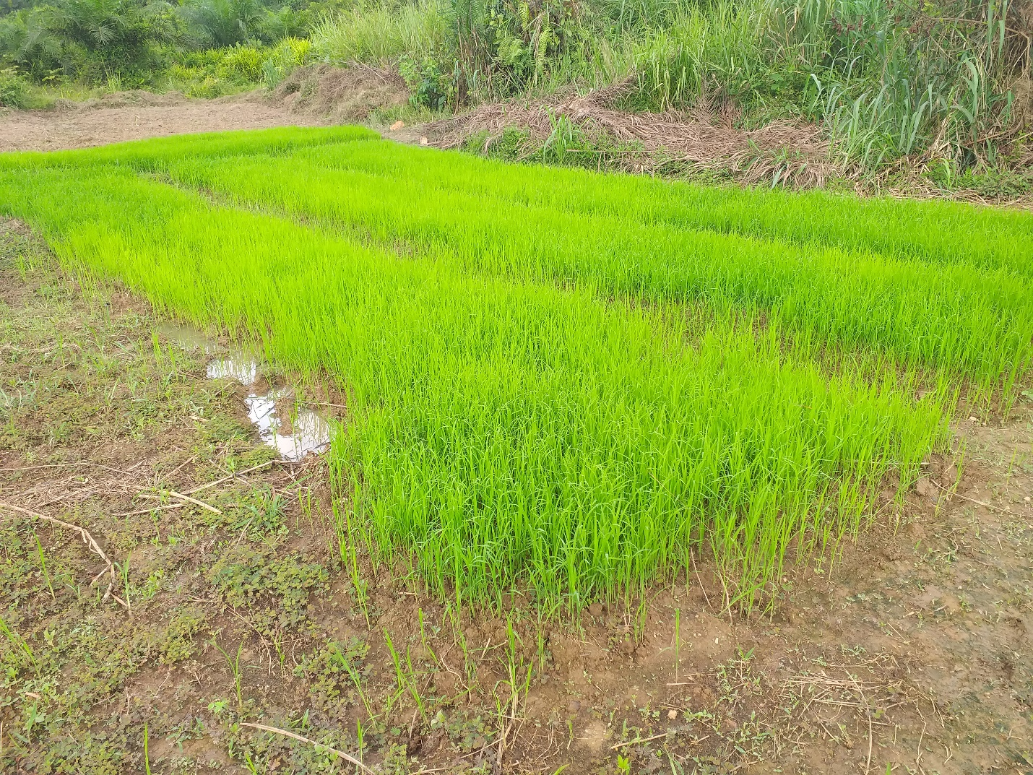
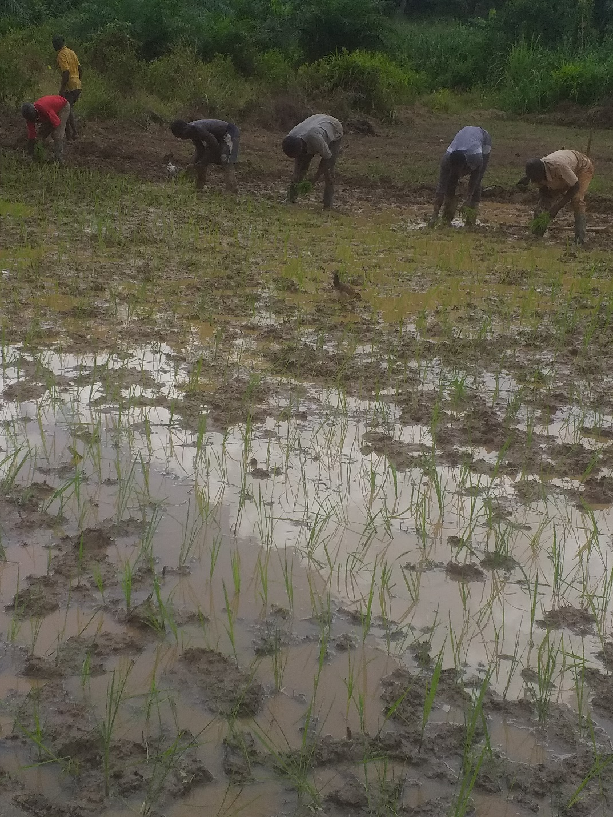
Five (5) rice demonstrations established at Kentey, Mmoodebam’, Mile 14, and Essaase.

Slide 23
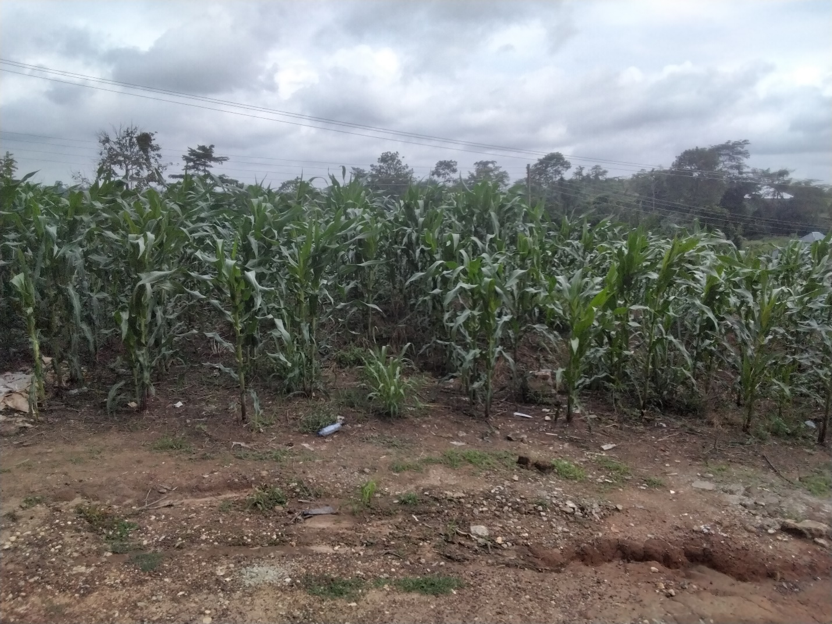
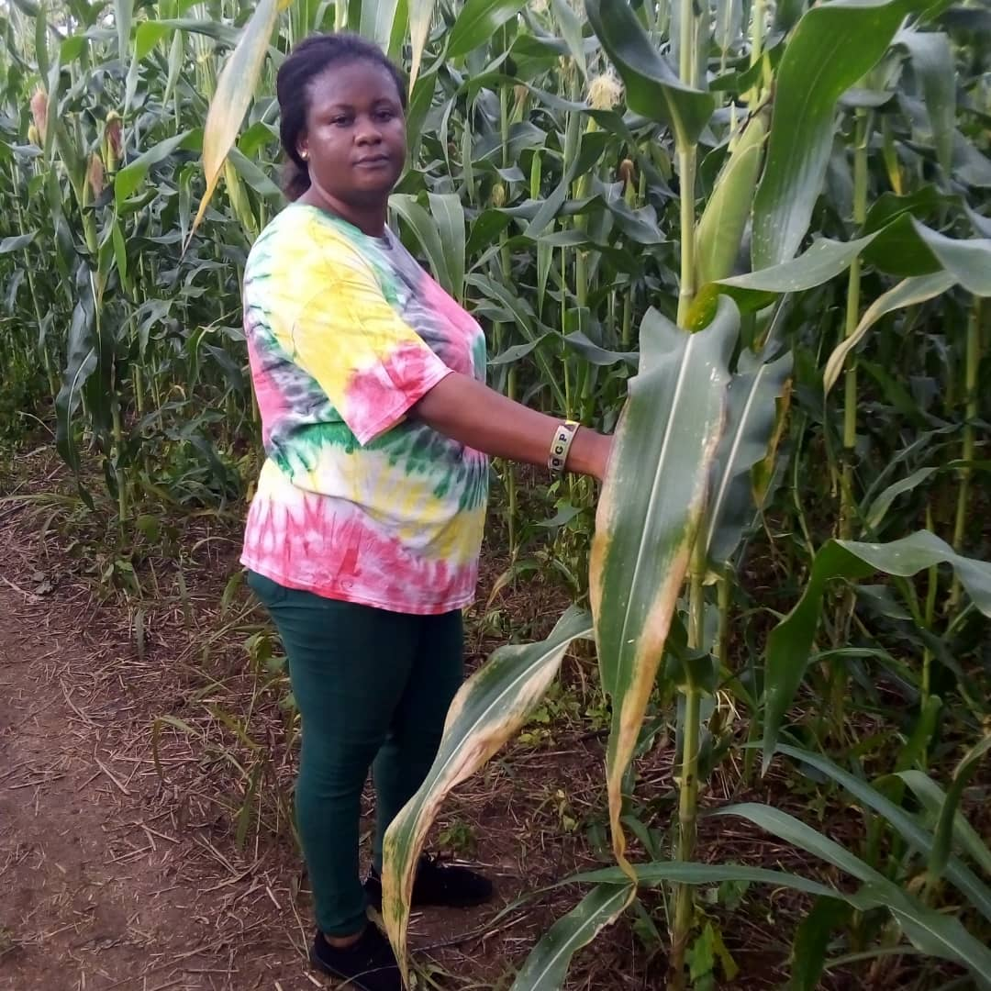
Seventeen (17) maize demonstrations conducted during the period at the office and all operational areas.

Slide 24
Policy Outcome Indicators and Targets
Outcome Indicator Description | Unit of Measurement | Baseline (2019) |  | Previous year’s performance (2020) |  | Current year’s Actual Performance (2021)
 |  | Target | Actual | Target | Actual | Target | Actuals as at July
Crops Production increased | Average Percentage increase in yield of food crops | 25% | 17% | 25% | 21% | 27% | 20%
Livestock Production increased | Average Number of livestock | 12,000 | 11,084 | 11,656 | 11,598 | 11,890 | 11,250
Access to safe water increased | Percentage of population with access to safe water | 90% | 75% | 80% | 78% | 81.20% | 70%
Access to communities enhanced | Length of Roads rehabilitated | 120km | 100km | 100km | 60km | 115km | -
Transparency and Accountability enhanced | Number of stakeholders meetings held | 4 | 2 | 4 | 2 | 4 | -
Quality of Education enhanced | Percentage of BECE candidates passed | 90% | 86% | 95% | 84% | 88% | -

Slide 25
KEY PERFORMANCE INFORMATION FOR BUDGET PROGRAMMES
(MANAGEMENT AND ADMINISTRATION)
Key/Main Outputs | Output Indicator | Past Years
 |  | 2020 Target | 2020 Actual | 2021 Target | 2021 Actual as at July
Assembly Meetings Organized | Number of Assembly Meetings held | 3 | 3 | 3 | 2
Administrative Reports prepared and submitted | Number of Quarterly administrative reports prepared and submitted on time | 4 | 4 | 4 | 2
Procurement Plan prepared | Procurement Plan prepared and submission by | 30th Nov. 2020 | 30th Nov. 2020 | 30th Nov. 2021 | -
Financial Reports | Annual Financial report produced by | 28th Feb. 2020 | 28th Feb. 2020 | 28th Feb. 2021 | 28th Feb. 2021
 | Number of Monthly Trial Balance produced by 15th of ensuing months | 12 | 12 | 12 | 6
Composite Action Plan | Annual Composite Action Plans produced by | 11th Oct,. 2020 | 11th Oct,. 2020 | 11th Oct,. 2021 | -
Composite Budget Prepared | District Composite Budget prepared and approved by | 30th Oct 2020 | 30th Oct 2020 | 30th Oct 2021 | -
Staff Development | Number of Staff trained | 70 | 30 | 75 | 45

Slide 26
KEY PERFORMANCE INFORMATION FOR BUDGET PROGRAMMES
(SOCIAL SERVICE DELIVERY)
Key/Main Outputs | Output Indicator | Past Years
 |  | 2020 Target | 2020 Actual | 2021 Target | 2021 Actual as at July
Preparation of reports | Quarterly report on PWDs registered, rehabilitated and supported | 4 | 4 | 4 | 2
Preparation of Report | Quarterly District Health report prepared | 4 | 4 | 4 | 2
Toilets Constructed | Number of Toilets constructed | 2 | 1 | 2 | -

Slide 27
KEY PERFORMANCE INFORMATION FOR BUDGET PROGRAMMES
(ECONOMIC DELIVERY)
Key/Main Outputs | Output Indicator | Past Years
 |  | 2020 Target | 2020 Actual | 2021 Target | 2021 Actual as at July
Farmers supported (financial & input) | Number of farmers supported | 4,000 | 3,120 | 4,000 | 2,862
Farmers trained on new farming techniques | Number of farmers trained | 5,500 | 3,875 | 5,000 | 3,412
Reshaping of Roads | Length of road reshaped | 100km | 70km | 120km | -

Slide 28
KEY PERFORMANCE INFORMATION FOR BUDGET PROGRAMMES
(INFRASTRUCTURE DELIVERY AND MANAGEMENT)
Key/Main Outputs | Output Indicator | Past Years
 |  | 2020 Target | 2020 Actual | 2021 Target | 2021 Actual as at July
Planning Schemes | Number Of Planning Schemes Prepared | 2 | 1 | 2 | 1
Supervise Community Initiated Projects | Number Of Community Initiated Projects Completed | 30 | 18 | 30 | 22

Slide 29
2021 Budget Programme Performance
Budget Programme | Budget | Actual as at July 2021
Management And Administration | 2,781,295.63 | 1,011,885.30
Infrastructure Delivery And Management | 4,946,772.14 | 1,306,002.12
Social Services Delivery | 1,535,057.00 | 143,998.44
Economic Development | 250,000.00 | 73,784.15
Environmental Management | 83,668.00 | 53,197.88
TOTAL | 9,596,792.77 | 2,588,867.89

Slide 30
Financials 2021 Key projects and programmes from all funding sources
No | Name of project | Amount budgeted | Actual Payment as at July, 2021 | Outstanding payment
1. | Construction Of 1no. 2unit Kg Block At Anyeme | 174,992.83 | 166,414.75 | 8,578.08
2. | Renovation Of Afoako R/C Jhs School Building | 86,886.00 | 86,886.00 | 0.00
3. | Provision Of 597 Dual Desks And 465 Mono Desks To Various Schools In The District. | 213,240.00 | 213,240.00 | 0.00
2. | Five (5) Rice Demonstrations Established At Kentey, Mmoodebam’, Mile 14, And Essaase. | 2,999.00 | 2,999.00 | 0.00
3. | Seventeen (17) Maize Demonstrations Conducted During The Period At The Office And All Operational Areas. | 3,000.00 | 3,000.00 | 0.00
 | TOTAL | 481,117.83 | 472,539.75 | 8,578.08

Slide 31
Sanitation Budget Performance
Liquid Waste
No | Name of Activity/Project | Budget | Actual as at July, 2021
 | Facilitate The Construction Of 30 Household Toilets | 20,000.00 | 0.00
 | Completion Of 20 Seater Wc Toilet At Jacobu Lorry Park | 130,000.00 | 122,817.30
 | TOTAL | 150,000.00 | 122,817.30
Solid Waste
No | Name of Activity/Project | Budget | Actual as at July, 2021
 | Sanitation Materials/Equipments | 7,500.00 | 0.00
 | Fumigation | 130,000.00 | 0.00
 | Sanitation Improvement | 150,000.00 | 0.00
 | Waste Management | 100,000.00 | 77,400.00
 | TOTAL | 387,500.00 | 77,400.00

Slide 32
DP Supported Programmes
Child Right and Protection
No | Name of Activity/Project | Budget | Actual as at July, 2021
 | Manage Cases of Child Labour, Child abuse, Child trafficking | 10,000.00 | 0.00
 | Organize Income generation activities through alternative livelihood programme. | 25,000.00 | 20,000.00
 | TOTAL | 35,000.00 | 20,000.00

Slide 33
DP Supported Programmes
MAG/CIDA
No | Name of Activity/Project | Budget | Actual as at July, 2021
1. | Internal Management | 35,095.72 | 10,284.15
2. | Human Resource Development and Management | 20,884.00 | 0.00
3. | Production and Productivity Improvement | 81,745.04 | 63,500.00
4. | Research, Statistics, Information and Communication | 185,390.24 | 0.00
5. | Early Warning Systems and Emergency Preparedness | 6,885.00 | 0.00
TOTAL |  | 250,000.00 | 73,784.15

Slide 34
Government Flagship Projects/Programmes
No | Name of Activity/Project | Budget | Actual as at July, 2021
 | Planting For Export And Rural Development - Perd | 12,000.00 | 2,000.00
 | Support Planting For Food And Job Activities | 20,000.00 | 2,357.92
 | Planting For Export And Rural Development - Perd | 10,000.00 | 0.00
 | Planting For Food And Job Activities | 250,000.00 | 71,784.15
 | Monitoring And Evaluation Of Free Education Programme | 4,000.00 | 1,200.00
 | Facilitate The Implementation Of One District One Factory | 10,000.00 | 0.00
 | TOTAL | 306,000.00 | 77,342.07

Slide 35
OUTLOOK FOR 2022

Slide 36
MMDA Adopted Policy Objectives for 2022
FOCUS AREA | ADOPTED POLICY OBJECTIVE | BUDGET ALLOCATION
Local Government And Decentralization | Deepen Political And Administrative Decentralization | 914,084.84
Strong And Resilient Economy | Ensure Improved Fiscal Performance And Sustainability | 950,000.00
Transport Infrastructure (Road, Rail, Water And Air) | Improve Efficiency And Effectiveness Of Road Transport Infrastructure And Services | 50,000.00
Water And Environmental Sanitation | Improve Access To Safe And Reliable Water Supply Services For All | 2,112,221.37

Slide 37
MMDA Adopted Policy Objectives for 2022
FOCUS AREA | ADOPTED POLICY OBJECTIVE | BUDGET ALLOCATION
Education And Training | Enhance Inclusive And Equitable Access To, And Participation In Quality Education At All Levels | 4,473,634.01
 | Strengthen School Management Systems | 473,367.73
Health And Health Services | Ensure Reduction Of New Hiv, Aids/Stis And Other Infections, Especially Among Vulnerable Groups | 1,000,727.73
 | Ensure Affordable, Equitable, Easily Accessible And Universal Health Coverage (Uhc) | 350,000.00

Slide 38
MMDA Adopted Policy Objectives for 2022
FOCUS AREA | ADOPTED POLICY OBJECTIVE | BUDGET ALLOCATION
Child And Family Welfare | Ensure Effective Child Protection And Family Welfare System | 30,000.00
Employment And Decent Work | Promote The Creation Of Decent Jobs | 15,000.00
Industrial Transformation | Ensure Energy Availability And Reliability | 10,000.00
TOTAL |  | 10,604,038.68

Slide 39
Policy Outcome Indicators and Targets
Outcome Indicator Description | Unit of Measurement | Baseline (2019) |  | Previous year (2020) |  | Current year (2021) |  | Budget year (2022) | Indicative year (2023) | Indicative year (2024) | Indicative year (2025)
 |  | Target | Actual | Target | Actual | Target | Actual as at July | Target | Target | Target | Target
Crops and Livestock Production increased | Average Percentage increase in yield of food crops | 25% | 17% | 25% | 21% | 27% | 20% | 28% | 30% | 32% | 34%
 | Average Number of livestock | 12,000 | 11,084 | 11,656 | 11,598 | 11,890 | 11,250 | 12,000 | 12,200 | 12,500 | 12,800
Access to safe water increased | Percentage of population with access to safe water | 90% | 75% | 80% | 78% | 81.20% | 70% | 80% | 82% | 84% | 86%
Access to communities enhanced | Length of Roads rehabilitated | 120km | 220km | 100km | 60km | 115km | - | 100km | 100km | 100km | 100km
Transparency and Accountability enhanced | Number of stakeholders meetings held | 4 | 2 | 4 | 2 | 4 | - | 4 | 4 | 4 | 4
Quality of Education enhanced | Percentage of BECE candidates passed | 90% | 86% | 95% | 84% | 88% | - | 95% | 95% | 95% | 95%

Slide 40
EXPENDITURE BY BUDGET PROGRAMME AND ECONOMIC CLASSIFICATION-ALL FUNDING SOURCES
BUDGET PROGRAMME | COMPENSATION OF EMPLOYEES | AMOUNT GH¢
 |  | GOODS & SERVICE | CAPITAL EXPENDITURE | TOTAL
Management And Administration | 1,459,642.93 | 2,083,492.00 | 642,000.00 | 4,065,496.79
Infrastructural Delivery And Management | 184,079.41 | 98,450.00 | 1,903,430.38 | 2,266,107.65
Social Services Delivery | 96,390.94 | 392,238.6 | 2,225,557.7 | 2,714,187.24
Economic Development | 445,195.66 | 351,000.00 | 0.00 | 796,195.66
Environmental Management | 234,193.34 | 397,858.00 | 130,000.00 | 762,051.34
TOTAL | 2,419,502.28 | 3,125,370.07 | 5,059,166.33 | 10,604,038.68

Slide 41
KEY PERFORMANCE INFORMATION FOR BUDGET PROGRAMMES
(MANAGEMENT AND ADMINISTRATION)
Key/Main Outputs | Output Indicator | Past Years |  |  |  | Projections
 |  | 2020 Target | 2020 Actual | 2021 Target | 2021 Actual As At July | Budget Year | Indicative Year | Indicative Year | Indicative Year
 |  |  |  |  |  | 2022 | 2023 | 2024 | 2025
Assembly Meetings Organized | Number of Assembly Meetings held | 3 | 2 | 3 | 2 | 2 | 3 | 2 | 3
Administrative Reports prepared and submitted | Number of Quarterly administrative reports prepared and submitted on time | 4 | 4 | 4 | 2 | 4 | 4 | 4 | 4
Procurement Plan prepared | Procurement Plan prepared by | 30th Nov. 2020 | 30th Nov. 2020 | 30th Nov. 2021 | - | 30th Nov.2022 | 30th Nov. 2023 | 30th Nov. 2024 | 30th Nov. 2025

Slide 42
KEY PERFORMANCE INFORMATION FOR BUDGET PROGRAMMES
(SOCIAL SERVICE DELIVERY)
Key/Main Outputs | Output Indicator | Past Years |  |  |  | Projections
 |  | 2020 Target | 2020 Actual | 2021 Target | 2021 Actual As At July | Budget Year | Indicative Year | Indicative Year | Indicative Year
 |  |  |  |  |  | 2022 | 2023 | 2024 | 2025
Preparation of reports | Quarterly report on PWDs registered, rehabilitated and supported | 4 | 4 | 4 | 2 | 4 | 4 | 4 | 4
Preparation of Report | Quarterly District Health report prepared | 4 | 4 | 4 | 2 | 4 | 4 | 4 | 4
Toilets Constructed | Number of Toilets constructed | 2 | 1 | 2 | - | 4 | 4 | 4 | 4

Slide 43
KEY PERFORMANCE INFORMATION FOR BUDGET PROGRAMMES
(ECONOMIC DEVELOPMENT)
Key/Main Outputs | Output Indicator | Past Years |  |  |  | Projections
 |  | 2020 Target | 2020 Actual | 2021 Target | 2021 Actual As At July | Budget Year | Indicative Year | Indicative Year | Indicative Year
 |  |  |  |  |  | 2022 | 2023 | 2024 | 2025
Farmers supported (financial & input) | Number of farmers supported | 4,000 | 3,120 | 4,000 | 2,862 | 4,200 | 4,500 | 4,600 | 4,800
Farmers trained on new farming techniques | Number of farmers trained | 5,500 | 3,875 | 5,000 | 3,412 | 5,000 | 5,000 | 5,000 | 5,000
Reshaping of Roads | Length of road reshaped | 100km | 70km | 120km | - | 160km | 180km | 200km | 220km

Slide 44
KEY PERFORMANCE INFORMATION FOR BUDGET PROGRAMMES
(INFRASTRUCTURE DELIVERY AND MANAGEMENT)
Key/Main Outputs | Output Indicator | Past Years |  |  |  | Projections
 |  | 2020 Target | 2020 Actual | 2021 Target | 2021 Actual As At July | Budget Year | Indicative Year | Indicative Year | Indicative Year
 |  |  |  |  |  | 2022 | 2023 | 2024 | 2025
Planning Schemes | Number Of Planning Schemes Prepared | 2 | 1 | 2 | 1 | 2 | 2 | 2 | 2
Supervise Community Initiated Projects | Number Of Community Initiated Projects Completed | 30 | 18 | 30 | 22 | 30 | 30 | 30 | 30

Slide 45
2022 EXPENDITURE BY BUDGET PROGRAMME, PROJECTS AND ECONOMIC CLASSIFICATION
BUDGET PROGRAMME | KEY PRIORITY PROJECT FOR 2022 | AMOUNT GH¢
 |  | GOODS & SERVICE | CAPITAL EXPENDITURE | TOTAL
Management And Administration | Valuation Of Properties And House Numbering Project | 20,000.00 | - | 20,000.00
 | Paving And Landscaping Of Administration Block | - | 250,000.00 | 250,000.00
Infrastructure Delivery And Management | Support Community Initiated Projects | - | 200,000.00 | 200,000.00
 | Construction Of 3 No.Boreholes District Wide | - | 109,479.00 | 109,479.00
 | Reshaping Of Roads | 150,000.00 | - | 150,000.00
 | Mechanization of 2No. Boreholes at Mile 9 and Esreso | - | 64,000.00 | 64,000.00
 | Construction Of 1No. Borehole at Jacobu | - | 25,000.00 | 25,000. 0
 | Construction of Lorry Park at Afoako | - | 550,000.00 | 550,000.00
Social Services Delivery | Furnishing Of 1No. CHPS Compound at Mile 18 | - | 50,000.00 | 50,000.00
 | Completion Of CHPS Compound At Akatakyieso | - | 17,816.71 | 17,816.71
 | Construction Of 3Unit Classroom Classroom at Nkoduase | - | 350,000.00 | 350,000.00
 | Completion Of 1 No. Dining Hall, JACOBU S H S (JASTECH,) | - | 30,000.00 | 30,000.00

Slide 46
2022 EXPENDITURE BY BUDGET PROGRAMME, PROJECTS AND ECONOMIC CLASSIFICATION
BUDGET PROGRAMME | KEY PRIORITY PROJECT FOR 2022 | AMOUNT GH¢
 |  | GOODS & SERVICE | CAPITAL EXPENDITURE | TOTAL
Social Services Delivery | Capacity building for staff of Education directorate and conduct INSET for teachers | 20,000.00 | - | 20,000.00
 | Completion Of 1 No. 3-unit Classroom Block (Kronko) | - | 16,000.00 | 16,000.00
 | Procure 2000 No. Dual Desk For Schools In The District | - | 420,000.00 | 420,000.00
 | Construction Of 1No. 3unit Classroom Block At Homasi | - | 280,000.00 | 280,000.00
 | Support The Construction Of 30 Household Toilet | 37,000.00 | - | 37,000.00
 | Completion of 20 Seater WC Facility at Jacobu Lorry Station. | - | 7,182.70 | 7,182.70
Economic Development | Planting For Export And Rural Development - PERD | 12,000.00 | - | 12,000.00
 | Support Planting For Food And Job Activities | 20,000.00 | - | 20,000.00
Environmental Management | Construction of District Police Headquarters at Jacobu | - | 542,000.00 | 542,000.00
 | Completion Of 1 No. Police Station (Apitisu) | - | 72,899.43 | 72,899.43
 | Construction of Security Post at Hia, Fiankoma, Numereso and Tweapease | - | 99,391.63 | 99,391.63
 | TOTAL | 259,000.00 | 3,083,769.47 | 3,342,769.47

Slide 47
2022-2025 REVENUE PROJECTIONS – IGF ONLY
ITEM | 2021 |  | 2022 | 2023 | 2024 | 2025
 | Budget | Actual as at July | Projection | Projection | Projection | Projection
Property Rate | 154,362.39 | 62,268.28 | 200,671.11 | 260,872.44 | 300,122.00 | 319,134.17
Other Rates | 1,200.00 | 0.00 | 1,200.00 | 1,300.00 | 1,400.00 | 1,500.00
Fees | 83,567.90 | 61,419.00 | 84,967.36 | 86,666.71 | 88,566.21 | 90,365.11
Fines | 5,000.00 | 0.00 | 5,000.00 | 5,000.00 | 5,000.00 | 5,000.00
Licence | 369,408.51 | 208,037.70 | 384,257.54 | 390,070.41 | 394,090.81 | 400,112.21
Land | 109,271.00 | 0.00 | 121,553.06 | 127,630.71 | 135,410.21 | 138,311.00
Rent | 19,933.20 | 9,490.00 | 21,139.16 | 23,561.94 | 25,500.00 | 27,800.00
Investment | - | - | - | - | - | -
Total | 742,743.00 | 341,214.98 | 818,788.23 | 895,102.21 | 950,089.23 | 982,222.49

Slide 48
Government Flagship Projects/Programmes For 2022
No | Type of Flagship project/programme | Name of Activity/Project | Budget | Funding Source
1 | Planting For Export And Rural Development - Perd | Facilitate The Adoption Of Existing Viable And Appropriate Technology | 22,000.00 | IGF,DACF
2 | Planting For Food And Job Activities | Introduce High Yield And Short Duration Crop For Farmers. | 270,000.00 | DACF,MAG
3 | Free Education Programme | Monitoring Of Various Basic Schools Within The District | 4,000.00 | DACF
 | TOTAL |  | 296,000.00

Slide 49
2022-2025 Expenditure Projections by Economic Classification- all funding sources
Expenditure items | 2021 budget | Actual | 2022 | 2023 | 2024 | 2025
 |  | As at July, 2021
Compensation | 2,184,911.63 | 1,098,374.28 | 2,419,502.28 | 2,520,000.00 | 2,604,911.63 | 2,787,005.00
Goods And Services | 2,716,851.14 | 963,293.94 | 3,125,370.07 | 3,216,851.14 | 3,442,191.03 | 3,500,000.00
Assets | 4,695,030.00 | 527,199.67 | 5,059,166.33 | 5,395,030.00 | 5,552,116.00 | 5,621,215.00
TOTAL | 9,596,792.77 | 2,588,867.89 | 10,604,038.68 | 11,131,881.10 | 11,599,218.66 | 11,908,220.00

Slide 50
SUMMARY OF EXPENDITURE BUDGET BY DEPARTMENT, ECON. CLASSIFICATION AND FUNDING SOURCES-2022
 | Department | Compensation | Goods and services | Assets | Total | Funding |  |  |  |  |  | Total
 |  |  |  |  |  | Assembly’s IGF | GOG | DACF | DACF-RFG | UNICEF ISS | MAG/CIDA
1 | Central Administration | 1,296,315.61 | 1,840,265.51 | 642,000.00 | 3,778,581.12 | 681,429.35 | 1,206,872.38 | 1,323,942.53 | 587,859.00 | - | - | 3,800,103.16
2 | Works | 160,227.27 | 98,450.00 | 2,027,061.37 | 2,285,738.64 | 52,000.00 | 182,010.03 | 913,249.51 | 1,138,479.10 | - | - | 2,285,738.64
3 | Agriculture | 445,195.66 | 351,000.00 | 0.00 | 796,195.66 | 15,500.00 | 445,195.66 | 85,500.00 |  |  | 250,000.00 | 796,195.66
4 | Social Welfare and Community Development | 96,390.94 | 217,500.00 | 0.00 | 313,890.94 | 3,958.45 | 110,022.35 | 169,910.14 | 0.00 | 30,000.00 |  | 313,890.94
 | Human Resource | 23,852.14 | - | - | 23,852.14 | 23,852.14 | 13,500.00 | - | - |  | - | 13,500.00
 | Statistics | 24,670.00 | - | - | 24,670.00 | 24,670.00 | 13,500.00 | - | - | - | - | 13,500.00
6 | Waste management | 234,193.34 | 397,858.00 | 130,000.00 | 762,051.34 | 4,858.00 | 234,193.34 | 523,000.00 | 0.00 | - | - | 762,051.34
10 | Physical Planning | 23,852.14 | 78,070.00 | 0.00 | 101,922.14 | 8,202.43 | 35,719.71 | 58,000.00 | 0.00 | - | - | 101,922.14
11 | Trade and Industry | 0.00 | 35,800.00 | 0.00 | 35,800.00 |  |  | 35,800.00 | 0.00 | - | - | 35,800.00
12 | Finance | 114,805.18 | 33,540.00 | 0.00 | 148,345.18 | 33,540.00 | 114,805.18 | 0.00 | 0.00 | - | - | 148,345.18
13 | Education youth and sports | 0.00 | 7,800.00 | 2,158,250.46 | 2,166,050.46 | 7,800.00 | 0.00 | 1,254,091.82 | 904,158.64 | - | - | 2,166,050.46
14 | Disaster Prevention and Management | 0.00 | 24,500.00 | 0.00 | 24,500.00 | 4,500.00 | 0.00 | 20,000.00 | 0.00 | - | - | 24,500.00
16 | Health | 0.00 | 40,586.56 | 101,854.50 | 142,441.06 | 7,000.00 | 0.00 | 85,401.41 | 50,039.65 | - | - | 142,441.06
 | TOTALS | 2,419,502.28 | 3,125,370.07 | 5,059,166.33 | 10,604,038.68 | 818,788.23 | 2,355,818.65 | 4,468,895.41 | 2,680,536.39 | 30,000.00 | 250,000.00 | 10,604,038.68

Slide 51
PROJECTS AND PROGRAMS FOR 2022 AND CORRESPONDING COST AND JUSTIFICATION
LIST ALL PR0JECTS | IGF (GH₵) | GOG (GH₵) | DACF (GH₵) | DDF (GH₵) | CIDA | TOTAL BUDGET (GH₵) | JUSTIFICATION- WHAT DO YOU INTEND TO ACHIEVE WITH THE PROGRAMMES/PROJECTS AND HOW DOES THIS LINK TO YOUR OBJECTIVES?
Compensation / 13% SSF Contribution | 125,488.82 | 1,731,200.96 | - | - | - | 2,380,012.00 | To Reward Staff For Work Done And To Improve Their Standard Of Living In Order To Deepen Political And Administrative Decentralization.
Transfer Grant | 26,328.76 | - | - | - | - | 26,328.76 | To Relieve The Costs And Inconveniences Of Staff Being Transferred To This District For The Purpose Of Deepening Political And Administrative Decentralization.
Commission For Revenue Collectors/Training Of Revenue Collectors/ Procure Required Logistics/ T & T For Revenue Collection / Value Books | 37,050.00 | - | - | - | - | 37,050.00 | To Reward Revenue Collectors And Procure Logistics To Strengthen Domestic Revenue Mobilization.
Assembly Members Allowance/ Special Allowance And Honorarium For Presiding Member | 34,200.00 | - | - | - | - | 34,200.00 | To Motivate The PM in the course of executing His Official Duties to Help Deepen Political And Administrative Decentralization.
Printed Material & Stationery | 6,000.00 | - | 25,000.00 | - | - | 31,000.00 | To Enhance Smooth Running Of The District To Deepen Political And Administrative Decentralization.
Office Facilities, Supplies & Accessories | 5,000.00 | - | 5,000.00 | - | - | 10,000.00 | To Enhance Smooth Running Of The District To Deepen Political And Administrative Decentralization.
Stakeholder / Public Fora | 5,000.00 | - | 30,000.00 |  | - | 35,000.00 | To Ensure Responsive Inclusive, Participation And Representation Decision Making In District
Maintenance & Repairs-official Vehicles | 5,000.00 | - | 35,000.00 |  | - | 40,000.00 | To Ensure Smooth Running Of The Office And Improve Transport And Road Safety For The Purpose Of Deepening Political And Administrative Decentralization

Slide 52
PROJECTS AND PROGRAMS FOR 2022 AND CORRESPONDING COST AND JUSTIFICATION
LIST ALL PR0JECTS | IGF (GH₵) | GOG (GH₵) | DACF (GH₵) | DDF (GH₵) | CIDA | TOTAL BUDGET (GH₵) | JUSTIFICATION- WHAT DO YOU INTEND TO ACHIEVE WITH THE PROGRAMMES/PROJECTS AND HOW DOES THIS LINK TO YOUR OBJECTIVES?
Running Cost-official Vehicles | 60,000.00 | - |  |  | - | 60,000.00 | To Ensure Smooth Running Of The Office For The Purpose Of Deepening Political And Administrative Decentralization
Travelling And Transport Allowance | 70,000.00 | - | - | - | - | 70,000.00 | To Ensure Smooth Running Of The Office For The Purpose Of Deepening Political And Administrative Decentralization
Repairs Of Office Buildings | 10,000.00 | - | - | - | - | 10,000.00 | To Provide And Maintain Residential And Office Accommodation To Deepen Political And Administrative Decentralization.
Maintenance Of Furniture & Fixtures | 3,000.00 | - | - | - | - | 3,000.00 | To Provide Conducive Office environment For Smooth Running Of Office For The Purpose Of Deepening Political And Administrative Decentralization.
Maintenance Of General Equipment | 5,000.00 | - | 30,000.00 | - | - | 35,000.00 | To Enhance Smooth Running Of Offices To Deepen Political And Administrative Decentralization.
Sub-committee, Executive / Assembly Meetings /Other Committee Meetings | 42,000.00 | - | 70,000.00 | - | - | 112,000.00 | To Meet Timely Meeting Schedules For Smooth Running Of The Office To Help Deepen Political And Administrative Decentralization.
Construction Of 3 No. Boreholes District wide | 25,000.00 | - | 60,000.00 | - 24,479.00 | - | 109,479.00 | To Provide Potable Water To Ensure Universal Access To Safe Drinking Water By 2030.
Reshaping Of100km Roads | 15,000.00 | - | 100,000.00 | - | - | 115,000.00 | To Improve on Efficiency & Effectiveness Of Road Transportation Infrastructure & Service In The District

Slide 53
PROJECTS AND PROGRAMS FOR 2022 AND CORRESPONDING COST AND JUSTIFICATION
LIST ALL PR0JECTS | IGF (GH₵) | GOG (GH₵) | DACF (GH₵) | DDF (GH₵) | CIDA | TOTAL BUDGET (GH₵) | JUSTIFICATION- WHAT DO YOU INTEND TO ACHIEVE WITH THE PROGRAMMES/PROJECTS AND HOW DOES THIS LINK TO YOUR OBJECTIVES?
Procure Low Tension Poles To Extend Electricity To Communities | 10,000.00 | - |  | - | - | 10,000.00 | To Ensure Universal Access To Affordable, Reliable & Modern Energy Services.
Sanitation Materials/Equipment | 5,000.00 | - | 6,000.00 | - | - | 11,000.00 | To Achieve Access To Adequate And Equitable Sanitation And Hygiene To Improve Environmental Health Within The District
Official Celebrations | 5,000.00 | - | 50,000.00 | - | - | 55,000.00 | To Provide Protocol Services And Support National Days Celebration To Deepen Political And Administrative Decentralization.
Support Community Initiated Projects | 10,000.00 | - | 65,573.12 | - | - | 75,573.12 | To Enhance Community Involvement In Economic Development
Renovation And Furnishing Of Official Bungalows | 2,000.00 | - | 40,000.00 | - | - | 42,000.00 | To Provide And Maintain Residential And Office Accommodation To Deepen Political And Administrative Decentralization.
Planting For Export And Rural Development - PERD | 12,000.00 | - | 10,000.00 | - | - | 22,000.00 | To Improve Production Efficiency And Yield In The District
Infectious Diseases Control | 49,392.00 |  |  |  |  | 49,392.00 | To limit, control, prevent and manage the spread of infectious diseases.
Completionon Of 1no. 2-unit Kg Block ( Anyeme) | - | - | 8,578.08 | - | - | 8,578.08 | To Ensure Quality Childhood Development., Care & Pre-primary Education

Slide 54
PROJECTS AND PROGRAMS FOR 2022 AND CORRESPONDING COST AND JUSTIFICATION
LIST ALL PR0JECTS | IGF (GH₵) | GOG (GH₵) | DACF (GH₵) | DDF (GH₵) | CIDA | TOTAL BUDGET (GH₵) | JUSTIFICATION- WHAT DO YOU INTEND TO ACHIEVE WITH THE PROGRAMMES/PROJECTS AND HOW DOES THIS LINK TO YOUR OBJECTIVES?
Completion Of 1no. 2-unit Kg Block ( Mile 9) | - | - | 7,774.51 | - | - | 7,774.51 | To Ensure Quality Childhood Development., Care & Pre-primary Education
Support To Planning (DPCU) | - | - | 8,000.00 | - | - | 8,000.00 | To Ensure Smooth Running Of The Office To Deepen Political And Administrative Decentralization.
Monitoring And Evaluation | - | - | 50,000.00 | - | - | 50,000.00 | To Ensure Smooth Running Of The Office To Deepen Political And Administrative Decentralization.
Support For STMIE Clinic | - | - | 10,000.00 | - | - | 10,000.00 | To Support Educational Activities To Ensure All Learners Acquire Knowledge. & Skills, To Promote. Sustainable. Development.
Scholarship And Bursary | - | - | 10,000.00 | - | - | 10,000.00 | To Support Educational Activities To Ensure All Learners Acquire Knowledge. & Skills, To Promote. Sustainable. Development.
Organize B.E.C.E Mock For JHS Students | - | - | 10,000.00 | - | - | 10,000.00 | To Support Educational Activities To Ensure All Learners Acquire Knowledge. & Skills, To Promote. Sustainable. Development.
Provide Support For Polio And Roll Back Malaria Programmes(0.5%) | - | - | 21,543.66 | - | - | 21,543.66 | To End Epidemics Of Aids, Tb, Malaria And Trop. Diseases By 2030
Provide Support For HIV/AIDS Programmes And Activities (0.5%) | - | - | 21,543.66 | - | - | 21,543.66 | To End Epidemics Of Aids, Tb, Malaria And Trop. Diseases By 2030

Slide 55
PROJECTS AND PROGRAMS FOR 2022 AND CORRESPONDING COST AND JUSTIFICATION
LIST ALL PR0JECTS | IGF (GH₵) | GOG (GH₵) | DACF (GH₵) | DDF (GH₵) | CIDA | TOTAL BUDGET (GH₵) | JUSTIFICATION- WHAT DO YOU INTEND TO ACHIEVE WITH THE PROGRAMMES/PROJECTS AND HOW DOES THIS LINK TO YOUR OBJECTIVES?
Farmers Day Celebration | - | - | 50,000.00 | - | - | 5 0,000.00 | To Motivate Citizens To Venture Into Agriculture And Existing Farmers To Increase Production In Other To End Hunger And Ensure Access To Sufficient Food
Support Sustainable Low Land Rice Production | - | - | 20,000.00 | - | - | 20,000.00 | To Improve Rice Production Efficiency And Yield In The District.
Completion Of 1 No. Police Station (Apitisu) | - | - | 23,298.80 | - | - | 23,298.80 | To Equip Security Personnel With Logistics And other support To Prevent Violence, Terrorism, And Crime
Completion Of 1 No. 3-unit Classroom Block at Kronko(Retention) | - | - | 16,000.00 | - | - | 16,000.00 | To Improve Access To Educational Infrastructure To Ensure Free, Equitable And Quality Education For All 2030.
Prepare Composite Budget And Supplementary Estimates | - | - | 5,000.00 | - | - | 5,000.00 | To Ensure Successful Preparation Of The Composite Budget And Smooth Running Of The Office To Deepen Political And Administrative Decentralization.
Disaster Prevention / Management | - | - | 20,000.00 | - | - | 20,000.00 | To Improve Disaster Prevention And Management To Reduce Vulnerability To Climate-related Events And Disasters.
Support The Construction Of 30 Household Toilets | - | - | 20,000.00 | - | - | 20,000.00 | To Improve Environmental Health To Ensure Sanitation For All And No Open Defecation By 2030.
Provide Support For Maintenance Of Security And Order/ Law Enforcement | - | - | 10,000.00 | - | - | 10,000.00 | To Equip Security Personnel With Logistics And Pay For Legal Expenses To Prevent Violence, Terrorism, And Crime
Waste Management | - | - | 100,000.00 | - | - | 100,000.00 | To Achieve Access To Adequate And Equitable Sanitation And Hygiene To Improve Environmental Health Within The District

Slide 56
PROJECTS AND PROGRAMS FOR 2022 AND CORRESPONDING COST AND JUSTIFICATION
LIST ALL PR0JECTS | IGF (GH₵) | GOG (GH₵) | DACF (GH₵) | DDF (GH₵) | CIDA | TOTAL BUDGET (GH₵) | JUSTIFICATION- WHAT DO YOU INTEND TO ACHIEVE WITH THE PROGRAMMES/PROJECTS AND HOW DOES THIS LINK TO YOUR OBJECTIVES?
Sanitation Improvement | - | - | 200,000.00 | - | - | 200,000.00 | To Achieve Access To Adequate And Equitable Sanitation And Hygiene To Improve Environmental Health Within The District
Completion Of 20 Seater WC Toilet at Jacobu Lorry Park. | - | - | 7,182.70 |  | - | 7,182.70 | To Improve on Environmental Health To Ensure Sanitation For All And No Open Defecation By 2030.
Completion Of CHPS Compound At Akatakyieso | - | - | 32,260.12 | - | - | 32,260.12 | To Improve on Hospital Infrastructure To Achieve Universal Health Coverage And Access To Quality Health Care Service.
Procure 2000 Dual and Mono Desk For Schools In The District | 200,000.00 | - | 78,000.00 | 355,000.00 | - | 633,000.00 | To Improve on Access To Educational Infrastructure To Ensure Free, Equitable And Quality Education For All 2030.
Construction Of 1no. 3unit Classroom Block At Homasi | - | - | 350,000.00 | - | - | 350,000.00 | To Improve on Access To Educational Infrastructure To Ensure Free, Equitable And Quality Education For All 2030.
Construction Of 1no. 3unit Classroom Block At Gyaman | - | - | 350,000.00 | - | - | 350,000.00 | To Improve on Access To Educational Infrastructure To Ensure Free, Equitable And Quality Education For All 2030.
Construction Of 1no. 3unit Classroom Block At Donkoase | - | - | 350,000.00 | - | - | 350,000.00 | To Improve on Access To Educational Infrastructure To Ensure Free, Equitable And Quality Education For All 2030.
Valuation Of Properties And House Numbering Project | - | - | 50,000.00 | - | - | 50,000.00 | To Ensure Easy Location Of Places And Houses To Enhance Inclusive Urbanization And Capacity For Settlement.
Construction of Cocoa Office at Mile 15 | - | - | 450,000.00 |  |  | 450,000.00 | To Improve Production Efficiency of Cocoa yield In The District

Slide 57
PROJECTS AND PROGRAMS FOR 2022 AND CORRESPONDING COST AND JUSTIFICATION
LIST ALL PR0JECTS | IGF (GH₵) | GOG (GH₵) | DACF (GH₵) | DDF (GH₵) | CIDA | TOTAL BUDGET (GH₵) | JUSTIFICATION- WHAT DO YOU INTEND TO ACHIEVE WITH THE PROGRAMMES/PROJECTS AND HOW DOES THIS LINK TO YOUR OBJECTIVES?
Capacity Building For Assembly Members And Staff | 8,000.00 | - | 35,000.00 | 45,859.00 | - | 88,859.00 | To Enhance on Effective And Efficient Service Delivery To Deepen Political And Administrative Decentralization.
Preparation Of Physical Planning Scheme | - | - | 20,000.00 | - | - | 20,000.00 | To Ensure A Well-planned Society To Aid Easy Location Of Places And Houses In Order To Enhance Inclusive Urbanization And Capacity For Settlement.
Training In Batik Tie & Dye And Soap Making | - | - | 10,000.00 | - | - | 10,000.00 | To Achieve Full And Productive Employment And Decent Work For All
Support Formation Of Local Business Association - LBA'S | - | - | 2,000.00 | - | - | 2,000.00 | To Achieve Full And Productive Employment And Decent Work For All
Completion Of 1 No. Dining Hall, Jastech | - | - | 30,000.00 | - | - | 30,000.00 | To Improve Access To Educational Infrastructure To Ensure Free, Equitable And Quality Education For All 2030
Complete Cladding Of 2 No. 6-unit Classroom (Fiankoma, Hia) | - | - | 7,000.00 | - | - | 7,000.00 | To Improve Access To Educational Infrastructure To Ensure Free, Equitable And Quality Education For All 2030
Monitoring And Evaluation Of Free Education Programme | - | - | 7,088.78 | - | - | 7,088.78 | To Effectively Monitor The Programme To Ensure Free, Equitable And Quality Education For All 2030.
Facilitate The Implementation Of One District one Factory | - | - | 10,000.00 | - | - | 10,000.00 | Promote Inclusive & Sustainable Industrialization And Create Employment
Support Planting For Food And Jobs Activities | - | - | 20,000.00 | - | - | 20,000.00 | To Improve Production Efficiency And Yield In The District
Procure 1 No. Motor Bikes For Environmental Health Officers | - | - | 5,000.00 | - | - | 5,000.00 | To Achieve Access To Adequate And Equitable Sanitation And Hygiene To Improve Environmental Health Within The District

Slide 58
PROJECTS AND PROGRAMS FOR 2022 AND CORRESPONDING COST AND JUSTIFICATION
LIST ALL PR0JECTS | IGF (GH₵) | GOG (GH₵) | DACF (GH₵) | DDF (GH₵) | CIDA | TOTAL BUDGET (GH₵) | JUSTIFICATION- WHAT DO YOU INTEND TO ACHIEVE WITH THE PROGRAMMES/PROJECTS AND HOW DOES THIS LINK TO YOUR OBJECTIVES?
Drilling and Mechanization of 1No. Borehole at Nankawura |  |  |  | 44,691.70 |  | 44,691.70 | To Provide Potable Water To Ensure Universal Access To Safe Drinking Water By 2030.
Support To Persons With Disability | - | - | 169,910.14 | - | - | 169,910.14 | To Ensure That PWDs Enjoy All The Benefits Of Ghanaian Citizenship
Completion Of 1 No. 2-unit Nurses Quarters at Oseikrom (Retention) | - | - | - | 15,039.00 | - | 15,039.00 | To Improve on Hospital Infrastructure And Accommodation To Achieve Universal Health Coverage And Access To Quality Health Care Service.
Construction of Lorry Park at Afoako | - | - |  | 550,000.00 | - | 550,000.00 | To Improve Efficiency & Effectiveness Of Road Transportation Infrastructure Service In The District
Construction 1 No. 3-unit Classroom Block at Abraso (Retention) | - | - | - | 19,349.98 | - | 19,349.98 | To Improve on Access To Educational Infrastructure To Ensure Free, Equitable And Quality Education For All 2030.
Furnishing Of CHPS Compound (Mile 18) | - | - | - | 35,000.00 | - | 35,000.00 | To Achieve District wide Health Coverage And Access To Quality Essential Health-care Services.
Construction of Court Complex at Jacobu |  |  |  | 542,000.00 |  | 542,000.00 | To ensure justice for the citizenry
Mechanization of 7No. Boreholes in the district. |  |  |  | 264,000.00 |  | 264,000.00 | To Provide Potable Water To Ensure Universal Access To Safe Drinking Water By 2030.
Agric CIDA | - | - | - | - | 250,000.00 | 250,000.00 | To Improve Production Efficiency And Yield In The District

Slide 59
PROJECTS AND PROGRAMS FOR 2022 AND CORRESPONDING COST AND JUSTIFICATION
LIST ALL PR0JECTS | IGF (GH₵) | GOG (GH₵) | DACF (GH₵) | DDF (GH₵) | CIDA | TOTAL BUDGET (GH₵) | JUSTIFICATION- WHAT DO YOU INTEND TO ACHIEVE WITH THE PROGRAMMES/PROJECTS AND HOW DOES THIS LINK TO YOUR OBJECTIVES?
Support Physical Planning Department Activities | 2,000.00 | 13,282.00 | - | - | - | 15,282.00 | To Enhance Inclusive Urbanization & Capacity For Settlement Planning
Support Agriculture Activities |  | 25,465.00 | - | - | - |  | To Improve Production Efficiency And Yield In The District
Support Social Welfare And Community Development Activities | 2,000.00 | 17,392.00 | - | - | - | 19,392.00 | To Ensure An End To All Forms Of Abuse, Exploitation And Violence In The District
Support Feeder Roads Activities | 2,000.00 | 23,627.00 | - | - | - | 25,627.00 | To Improve Efficiency & Effectiveness Of Road Transportation Infrastructure & Service In The District
Support Human Resource Department Activities | 1,000.00 | 13,500.00 | - | - | - | 14,500.00 | To be well equipped with computer knowledge
Support Statistics Department Activities | 1,000.00 | 13,500.00 | - | - | - | 14,500.00 | To ensure the effective utilization of statistical tools in analyzing statistical data.

Slide 60
Sanitation Budget
Liquid Waste
No | Name of Activity/Project | Budget
 | Completion Of 20 Seater Wc Toilet At Jacobu Lorry Park | 7,182.70
 | Support The Construction Of 30 Household Toilet | 37,000.00
Solid Waste
No | Name of Activity/Project | Budget
 | Sanitation Materials/Equipments | 7,500.00
 | Fumigation | 130,000.00
 | Sanitation Improvement | 150,000.00
 | Waste Management | 100,000.00

Slide 61
DP SUPPORT.
Child Right and Protection
No | Name of Activity/Project | Budget
1. | Organise Child Protection Programmes (Child Trafficking, Labour, Abuse) | 10,000.00
2. | Income Generation Activities Through Alternative Livelihood Programme | 20,000.00
 | TOTAL | 30,000.00

Slide 62
DP SUPPORT - SOCIAL PROTECTION
MAG/CIDA
No | Name of Activity/Project | Budget
1. | Internal management | 35,095.72
2. | Human Resource Development and Management | 20,884.00
3. | Production and Productivity Improvement | 81,745.04
4. | Research, Statistics, Information and Communication | 185,390.24
5. | Early Warning Systems and Emergency Preparedness | 6,885.00
TOTAL |  | 250,000.00

Slide 63
COMPENSATION OF EMPLOYEES
SN | DEPARTMENT | NUMBER AT POST - IGF | NUMBER AT POST - GoG | AMOUNT
1. | Central Administration | 8 | 29 | 1,296,315.61
2. | Finance | 0 | 4 | 114,805.18
3. | Human Resource | 0 | 1 | 23,852.14
4. | Statistics | 0 | 1 | 24,670.00
5. | Environmental Health | 4 | 16 | 234,193.34
6. | Agriculture | 0 | 15 | 445,195.66
7. | Social Welfare & Community Development | 0 | 4 | 96,390.94
8. | Physical Planning | 0 | 1 | 23,852.14
9. | Works | 6 | 5 | 160,227.27
 | GRAND TOTAL | 18 | 76 | 2,419,502.28

Slide 64
STAFF GOING ON RETIREMENT IN 2022
S/N | STAFF ID | CURRENT GRADE / POSITION | DATE OF APPOINTMENT | DATE OF RETIREMENT
1 | 52492 | Chief Head Conservancy | 16/01/1990 | 21/09/2022

Slide 65
Conclusion
PROVISION OF TECHNICAL SUPPORT
Ashanti Regional Coordinating Council ( ARCC )
National Team – Ministry Of Finance
CHAIRMAN FOR HEARING
HON. REGIONAL MINISTER (ASHANTI REGION)
LEAD PERSONEL FOR DISCUSSION
Hon. Michael Donkor
( DCE. AMANSIE CENTRAL DISTRICT ASSEMBLY )

Slide 66

THANK YOU

