Slide 1
National Security & National Security Framework for Countering Violent Extremism and Terrorism in Ghana
‘The Threats And Challenges Of National Security Provision In Ghana’

Slide 2
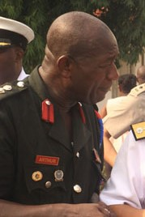
SPEAKER
COLONEL KOFI ARTHUR (RTD)
REGIONAL SECURITY LIASON OFFICER (RSLO) ASHANTI REGION
DATE: 5TH AUGUST – 18TH OCTOBER 2022

Slide 3
INTRODUCTION
One of the complex issues in the 21st century is the provision of state security in the contemporary democratic global governing environment. This global governing environment is fraught with daunting and unprecedented complex threats and challenges to state security. This trend of affairs has been revolutionarised by the dramatic increased pace in establishing closer contacts in the world in recent times, termed globalization.
Globalization has brought in its wake interdependence and technological advantages to the extent that countries are brought much closer than ever through movement by air, extensive use of telephone and the internet, easy access and fast capital flows. Increased trade and operation of multinational corporations and the increased actions of international organizations all point to the fact. Despite the numerous advantages of globalization, it has also brought about some security challenges propelled by “extreme violence, armed conflict, terrorism

Slide 4
INTRODUCTION (‘Cont’d)
Nations and states in their bid to providing security to protect their people and resources, have come face to face with “new insecurities and globalised violence” even beyond their borders. In the global context, the activities of non-state actors, terrorist, organized international crime, small arms proliferations, extreme violence, terrorism and conflicts have been the pre-occupation of non state actors.
At the regional and domestic level constitutional rights to freedom of expression, the right to organize political demonstrations and protests, ethnic conflicts and other internal scrabbles all impinge on the provision of national security. States are therefore grappling with these security challenges to ensure stability, peace and durable democratic governance.

Slide 5
INTRODUCTION (‘Cont’d)
Some major vents have necessitated changes in the course of global history. Example of such major events is the 9/11 attacks on USA. Many countries across the globe put in place measures to prevent or minimise such attacks.
However, West Africa seem not to have cared until groups like Ansar Dine, Boko Haram and others started emerging.
In recent years , West Africa has experienced growth in violent extremism and terrorism. This is basically led by Boko Haram, a group which has devastated lives in Nigeria and Cameroun in the Lake Chad Basin. Their operations have taken place in Mali, Nigeria, La Cote D’Ivoire, Burkina Faso, Chad and Togo. Ghana is currently among the few countries in West Arica that has not experienced open terrorist attacks in West Africa.

Slide 6
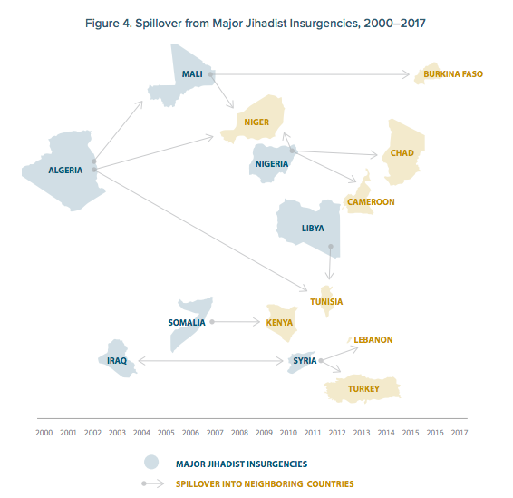
SPILL OVER FROM ……..

Slide 7
AIM
The purpose of this presentation is to examine Ghana’s challenge’s in providing security in a globalised world and its management of Violent Extremism and Terrorism.

Slide 8
SCOPE
Definitions
The essence of National Security.
The National Security Structure.
Identify some threats to Ghana’s National Security
Explore the challenges to Ghana’s National Security from the global through regional to the domestic perspective.
Seek the Way Forward

Slide 9
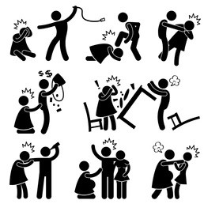
DEFINITIONS
VIOLENT:
Using or involving force intended to hurt, harm, damage or kill someone destroy something INTENTIONALLY.
Very powerful or strong dislike.

Slide 10

DEFINITIONS (CONT’D)
EXTREMISM
A person who holds extreme political or religious views, especially one who advocates illegal, violent or other extreme actions.
It is the state of being extreme or the promotion of extreme measures or views.
Extremism is usually used in political or religious sense. It is considered to be outside the mainstream of attitudes of society

Slide 11
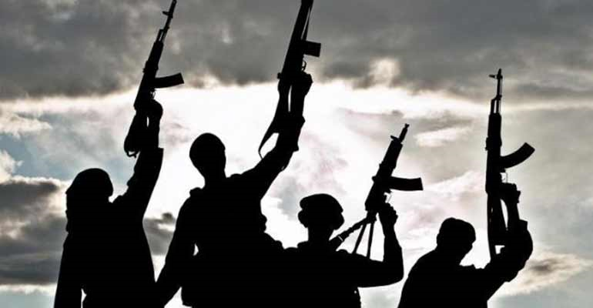
DEFINITIONS (CONT’D)
VIOLENT EXTREMISM
The FBI defines Violent Extremism as “encouraging, condoning, justifying or supporting the commission of a violent act to achieve political, ideological, religious, social or economic goals”.
It is advocating, engaging in, preparing or otherwise to undertake such activities.
NOTE: Not all extremist are violent

Slide 12
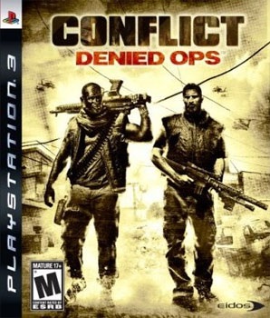
DEFINITIONS (CONT’D)
TERRORISM
The unlawful use of violence and intimidation, especially against civilians, in pursuit of political religious and cultural aims and beliefs.
Calculated use of unlawful violence to inculcate fear; intended to coerce or intimidate govts or societies in pursuit of goals that are generally political, religiousor ideological.
(Amammosem or Atuatee)

Slide 13

DEFINITIONS (CONT’D)
GLOBALIZATION
Globalization is the word used to describe the growing interdependence of the world's economies, cultures, and populations, brought about by cross-border trade in goods and services, technology, and flows of investment, people, and information.

Slide 14
THE ESSENCE OF
NATIONAL SECURITY
Security, an intangible good or service, is not easily noticed, felt and appreciated until its sudden disappearance which brings about disastrous effects which could be physical, moral, economic, political or financial, etc. States provide security to safeguard its national interest, the safety of its people, give secured environment, defend its territorial integrity, secure its natural resources, and protect the rights of its people.
At the strategic level, the political leadership, vital interest and key strategic resources and assets become the priority as any attack on/and loss of them would bring about instability, economic loss, a state of fear and panic and other consequences. The operational and tactical levels work towards the strategic level

Slide 15
THE ESSENCE OF
NATIONAL SECURITY (CONT’D)
The meaning of national security has been a problematic issue since there is no consensus on an acceptable definition for it. Hence a concept is rather used to explain what it means depending on the standpoint of the interpreter. The essence may be discernible from the strategic thinking through to the operational and tactical levels.

Slide 16
THE ESSENCE OF
NATIONAL SECURITY (CONT’D)
When this discussion is in the context of international system, security is about the ability of states and societies to maintain their independent identity and their functional integrity”. (Baylis, J. and Smith, S. 2001: 255)
Peter Gill, observed that when it comes to national security, the individual depends on some collectivity for personal security and therefore has completely subordinated their individuality to the state. (Gill, P. 1994)

Slide 17
NATIONAL SECURITY
It is very difficult to define National Security because each nation has its own definition, however most definitions agree on the ability of a country's government to protect its citizens, economy, and other institutions using any means necessary.
Examples:
Russia – Ukraine
The Gulf War
The Gaza War
Iraq Invasion

Slide 18

What is Ghana’s National Security System
Ghana’s national security is an executive-led function within the constitutional framework. Article 83(1) provides that there shall be a National Security Council (NSC) consisting of the President, the Vice President …………

Slide 19
What is Ghana’s National Security System (Cont’d)
The constitution did not state in clear terms how the National security system should be wired, however the representation of Minister’s of Foreign Affairs, Defence, Interior, Finance and all heads of the security service’s give an inkling of the how the structure should look like.

Slide 20
What is Ghana’s National Security System (Cont’d)
The President shall preside at the meetings of the National Security Council (NSC) and in his absence the Vice-President shall preside.
The NSC among other functions shall ensure the following:
Consider and take appropriate measures to safeguard the internal and external security of Ghana. Eg Haiti
Taking appropriate measures regarding the consideration of policies on the nature of common interests to the departments and agencies of the Government concerned with national security.

Slide 21
Examining Threats to Ghana’s National Security
Ghana is not insulated from threats which are varied and interrelated often transcending international borders.
The nature of security threats has a bearing on Ghana’s National Security policy formulation, the identification of such threats is necessary in order to prepare the nation and its people including the mandated institutions to be responsive.
Some of the threats are domestic in nature while others are of international character. They will be classified an INTERNAL and EXTERNAL threats

Slide 22
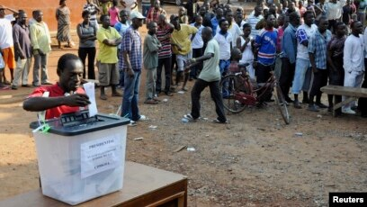
INTERNAL THREATS
The threats discussed are not in order of magnitude. But firstly Electoral Disputes and Violence have emerged on our political scene since 1993 when Ghana decided to adopt democratic governance.
Lives have been lost and the society gradually being polarized along political lines, mainly NPP- NDC.

Slide 23

INTERNAL THREATS (Cont’d)
Radio and TV allows for the transmission of news, music and never imagined things.
Unhealthy and inflammatory political utterances on airwaves, platforms and programs, directed at certain ethnic groups, political parties and others are potentials for political explosion and violence.
Example
Rwanda Genocide

Slide 24
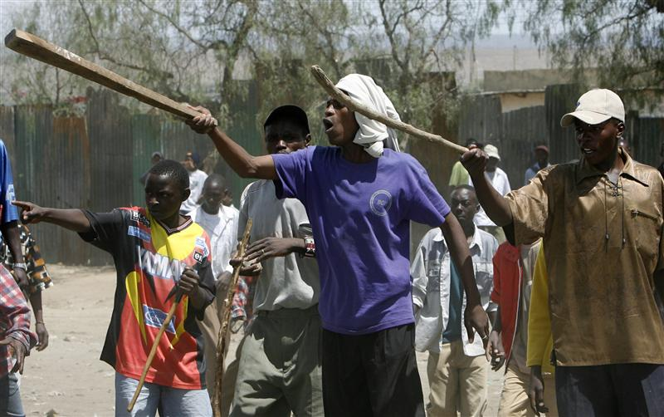
INTERNAL THREATS (Cont’d)
Secondly, ethnic and tribal conflicts over land such as the
Dagbon-Konkomba-Nanumba
&
Nkonya-Alavanyo
disputes remain unresolved.

Slide 25

INTERNAL THREATS (Cont’d)
Numerous chieftaincy disputes with political undertones such as the Bawku and Dagbon are also hanging in the balance.

Slide 26
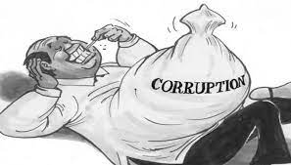
INTERNAL THREATS (Cont’d)
Corruption,
Youth Unemployment and
Abuse of Fundamental Human Rights
are on the increase.

Slide 27
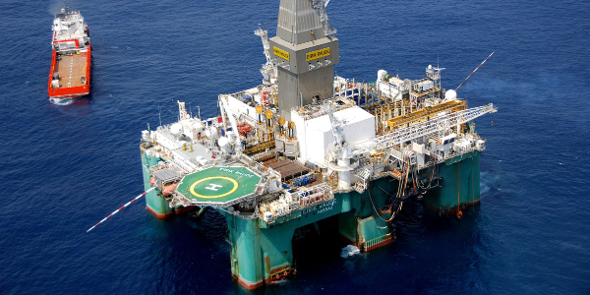
INTERNAL THREATS (Cont’d)
Attacks on Ghana’s new found oilfields offshore and sabotage of the onshore oil infrastructure as being witnessed in Nigeria worthy of mention. This would lead to serious economic loss and deny the country the needed revenue for the country’s developmental agenda.

Slide 28
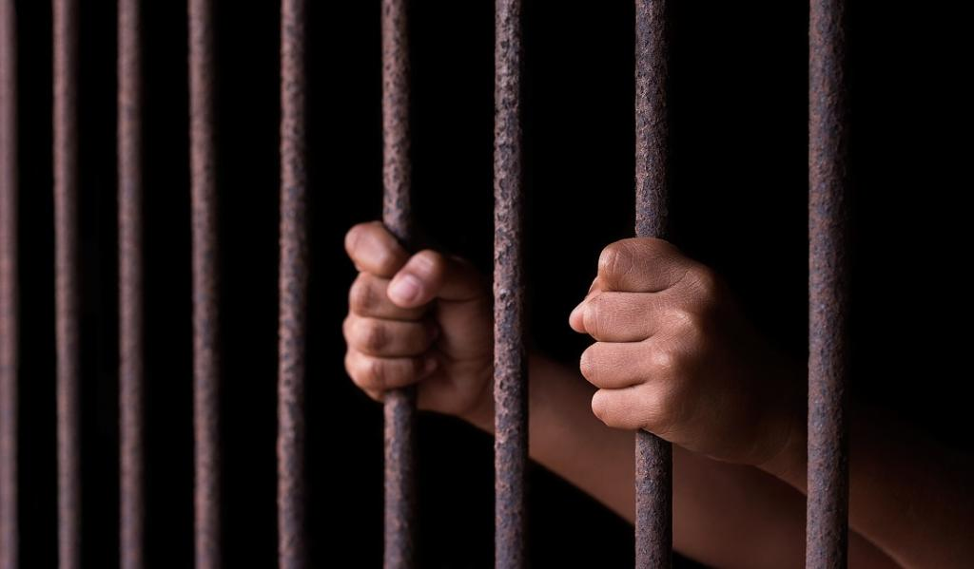
INTERNAL THREATS (Cont’d)
Drugs and Human Trafficking due to our porous borders remain menace to the country’s national security

Slide 29
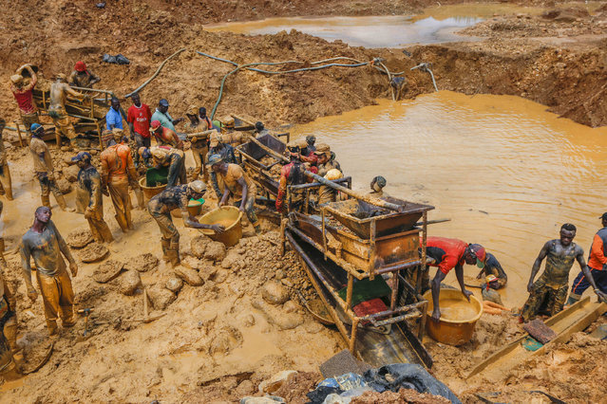
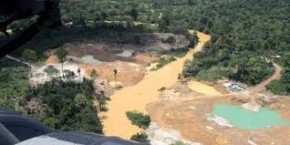
INTERNAL THREATS (Cont’d)
A variety of environmental issues such as natural disasters (earthquakes, flooding and bushfires), the degradation of the forest and plundering of its resources, pollution of waters sources are starring at the nation and likely to deprive future generations of these important heritages

Slide 30

INTERNAL THREATS (Cont’d)
Assassinations and attempts on the lives of government officials, political figures and individuals are a reality and strategies for their protection should be priority

Slide 31
GLOBAL & REGIONAL THREATS (EXTERNAL)
The trend of security threats seems to be the same for global and regional level with some peculiarities.
International Terrorism in its diverse forms and fundamentalism are at our nose.
With the technological advancement, the training, movement and facilitation of Terrorist Activities have left most developing nations helpless.
Typical examples are the imposition of Sharia Law among Muslim faithfuls and the activities of Boko Haram group in Nigeria are not far from reaching Ghana.

Slide 32
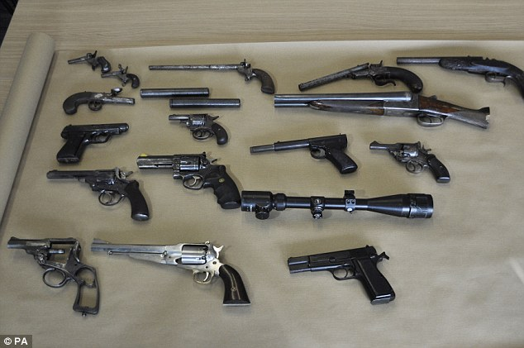
GLOBAL & REGIONAL THREATS ((EXTERNAL) CONT’D)
Small arms proliferations due to poor monitoring and porous frontiers.
Illegal trade and organized crime all undermine the stability and integrity of the state.

Slide 33
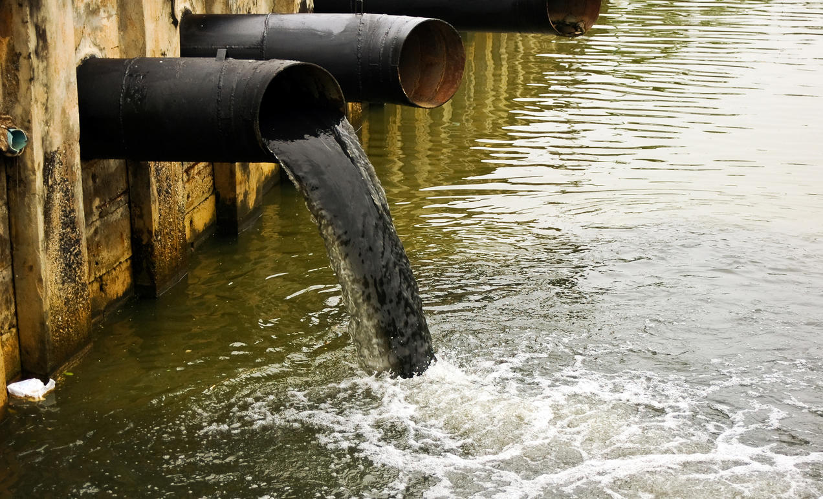
GLOBAL & REGIONAL THREATS ((EXTERNAL) CONT’D)
Environmental pollution and dumping of industrial waste in our territorial waters have come with economic and social costs.

Slide 34

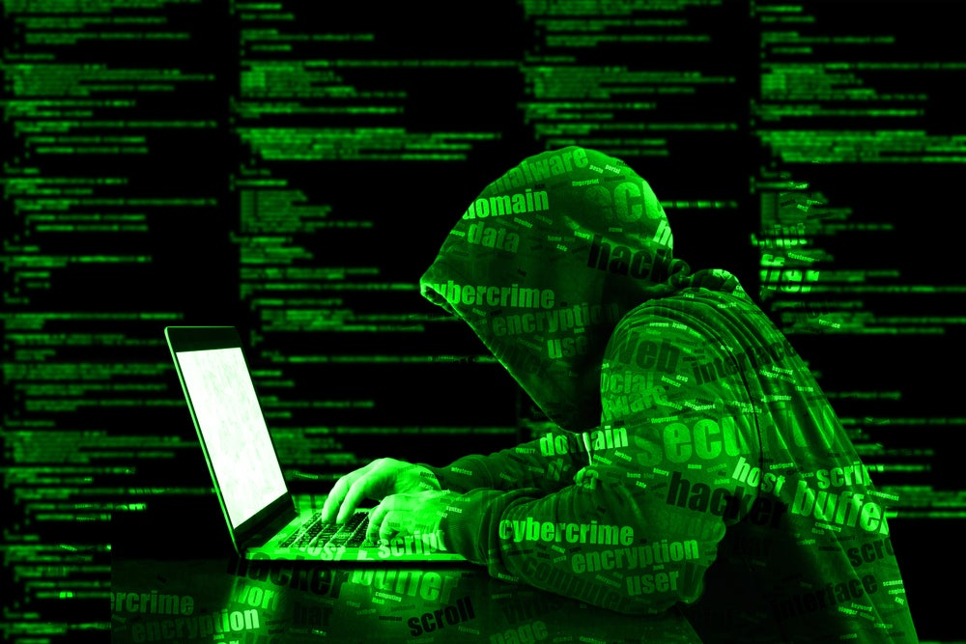
GLOBAL & REGIONAL THREATS ((EXTERNAL) CONT’D)
International Money Laundering and Cyber Fraud have become the order of the day and discourage foreign investment.
The activities of non-state actors have proved in recent times that states no longer have absolute or supreme over her sovereign affairs

Slide 35

GLOBAL & REGIONAL THREATS ((EXTERNAL) CONT’D)
Scalp: $607
Pair of Eyeballs: $1,525
Skull with Teeth: $1,200
Shoulder: $500
Coronary Artery: $1,525
Heart: $119,00
Liver: $157,000
Kidney:
  PARAGUAY: $15,000
  CHINA: $62,000
  USA: $262,000
Pint of Blood:
  PARAGUAY: $25
  USA: $337
Hand and Forearm: $385
Spleen: $508
Stomach: $508
Small Intestine: $2,519
Gallbladder: $1,219

Slide 36
THE SECURITY CHALLENGES
Threat based:
Having profiled some of the potential threats to Ghana, one of the challenges is the detection, the correct identification and locating of the threat and how to deal with it.
Terrorist activities are very clandestine that information gathering and detection, identification and locating the perpetrator have eluded most governments including Ghana.
Threat and risk analysis remain a daunting task due to lack of experts in that field. In this regard a collaborative effort in partnership with regional and international organizations as “security is best assured through a legitimate international order based on shared democratic values.” (Luckham, R. 2003)

Slide 37
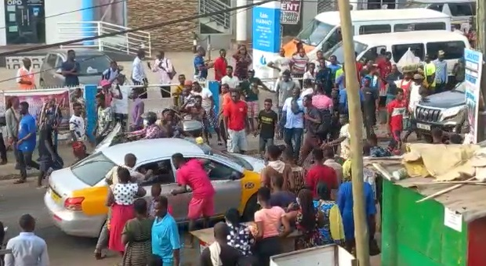
THE SECURITY CHALLENGES CONT’D
Increase in poverty and income differentiation among social groups.
Mass strikes and civil unrest.
Challenges in the public health sector.
Problems of integration of ethnic minorities.
Global Network (ISIS, Boko Haram, etc.)

Slide 38
THE SECURITY CHALLENGES CONT’D
Lack of & Weak Institutional Capacity:
National security is best assured through the National Security policy framework which set out security objectives, directions and guidelines to the ministries and institutions for implementation.
The first line and operational institutions are the security forces or services (Armed Forces, the , Fire Service, Prisons, GIS and other Paramilitary Agencies) which do not have the capacity and clout to deal with the particular threats.
The state investigative and control institutions and intelligence agencies seem weak and not very effective. Regime security seems to be the norm of the day.

Slide 39
THE SECURITY CHALLENGES CONT’D
Low levels of training, lack of expertise, resources constraints all underpin the effective performance of the state institutions. It is hoped that with the current on-going acquisition plan, the security forces would be well equipped to deal with the potential threats being faced.
Public order policing by the national police service has not improved due to the caliber of personnel recruited. Some criminal investigations are never completed and it is therefore difficult to bring criminals to justice.
Coordination and support is lacking between these state institutions. State prosecutions have failed several times in court.

Slide 40
THE SECURITY CHALLENGES CONT’D
Low Defence Budget:
In Ghana, defence has the lowest budgetary allocation and this affects the acquisition of equipment and training. Training in our military institutions has not varied significantly. However anti-terrorist unit has recently been formed but the concentration is in the north.
If the overall defence budget is not increased for the recruitment of personnel, acquisition of equipment and training, Ghana cannot deal effectively with the threat around.
An upward increase in the defence budget needs reconsideration.

Slide 41
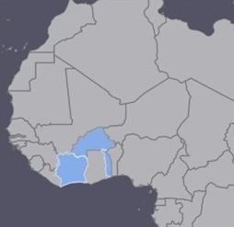
THE SECURITY CHALLENGES CONT’D
Extremist may take advantage of one or more of the situations listed above and use it to radicalize people

Slide 42
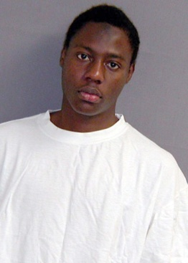
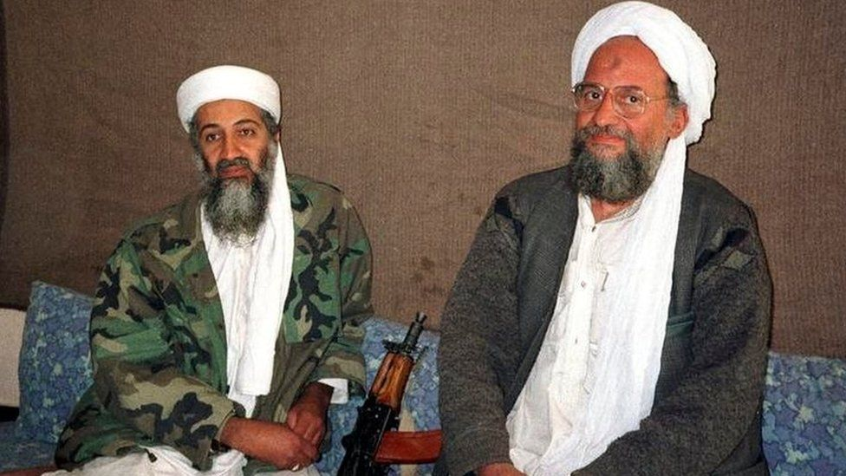
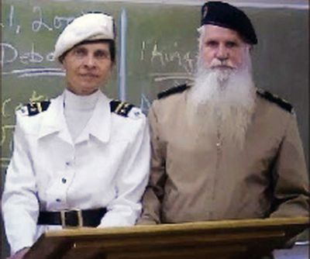
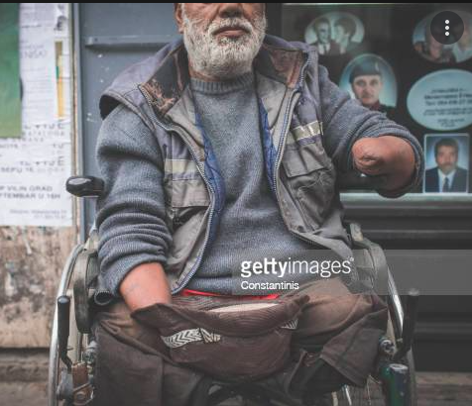
THE SECURITY CHALLENGES CONT’D
All manner of people can be compromised, the rich, the poor, Christians-The Army of God, Muslims-Boko Haram and all religious sects.
Muslim
The rich
Christian
The poor

Slide 43
THE WAY FORWARD
It is not enough to just examine the challenges. It is equally proper to seek a way forward.
Institutional capacity building and training of experts for threat and risk analysis and a collaborative effort in partnership with regional and international organizations should be a priority.
Security and development should be seen as complimentary goods and be given equal attention. Therefore the national defense budget should be raised upwards by 2 percent so that the acquisition plan for the security forces would be on course and equip them to deal with the potential threats being faced.

Slide 44
THE WAY FORWARD CONT’D
Non-state actors:
The notorious and nefarious activities of non-state actors who turn to be collaborators with enemies of the state are a real challenge to overcome.
The state has no control over non-state actors like drug barons, facilitators of terrorism, and international weapon dealers.
The presence and use of the Ghanaian territory as transit points were experienced recently thus dragging the name of the country in disrepute. Some non-state actors could facilitate dissidents to destabilize the state.
This calls for extra vigilance on the part of the government and the citizens. Effective monitoring of all entry and exit points should be MUST.

Slide 45
CONCLUSION
Globalisation has brought good social transformation and at the same time unprecedented complex threats and challenges to national security.
The threats of terrorism, organised international crimes, small arms proliferations, armed violence and conflicts have been the new threats than conventional war.
Coupled with these are economic/political demonstrations and protests, ethnic conflicts, ethnic and land disputes, electoral disputes and violence among others. Ghana is not insulated from mentioned threats.

Slide 46
CONCLUSION CONT’D
The nature of security threats has a bearing on national security policy formulation, the identification of such threats is therefore necessary in order to prepare the nation and its people including the mandated institutions to be responsive.
The object of national security is to safeguard the internal and external security of Ghana. While doing so and faced with the current trend of threats, challenges are bound to emerge.
Some of the challenges are threat-based, lack of institutional capacity, weak state institutions, low budgetary allocation for the security services, and activities of non state actors.

Slide 47
CONCLUSION CONT’D
The way forward was lies in institutional capacity building and training of experts for threat and risk analysis.
A collaborative effort in partnership with regional and international organisations required to deal with threats. For low budgetary allocation increase in defence budget by 2 percent will help the acquisition plan to equip security forces to deal with the potential threats being faced.
The strengthening of state institution and their transformation to meet the global trend is a requirement.
As regards non-state actors, extra vigilance on the part of the government and the citizens should be a priority with effective monitoring of all entry points.

Slide 48


Slide 49
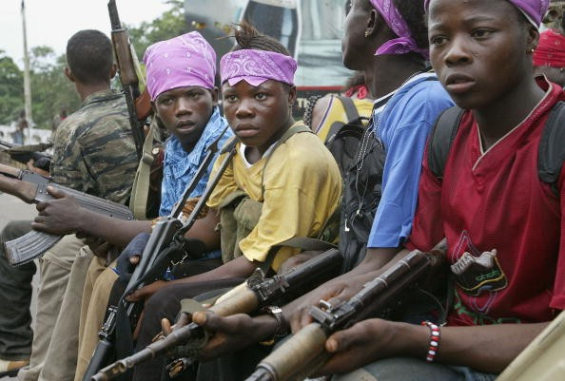

Slide 50
QUESTIONS
CLARIFICATIONS
SUGGESTIONS

Slide 51

THANK
YOU

Slide 52
REFERENCES
Luckham, R. (2003). “Democratic Strategies for Security in Transition and conflict” in Gavin Cawthra and Luckham, R. (eds) Governing Insecurity: Democratic Control of Military and Security Establishments in Transitional Democracies, London, Zed Books Ltd.
Baylis, J. (2001) “International and Global Security in the Post-Cold War Era” Baylis, J. and Smith, S.; eds, The Globalization of World Politics: An Introduction to International Relations, 2nd ed. New York, Oxford University Press Inc,.
Gill, P. (1994) Policing Politics: Security Intelligence and the Liberal Democratic State, England, FRANK CASS & CO. LTD
Crocker, Chester A., Hampson, Fen Osler, and Aall Pamela R; eds, Managing Global Chaos: Sources of and Responses to International Conflict (Washington, DC, United States Institute of Peace Press, 1996
Defence White Paper of Bosnia Herzegovina, June 2005.
Steger Manfred, B. (2003), Globalisation: A Short Introduction, New York, Oxford University Press Inc

